Slide 1
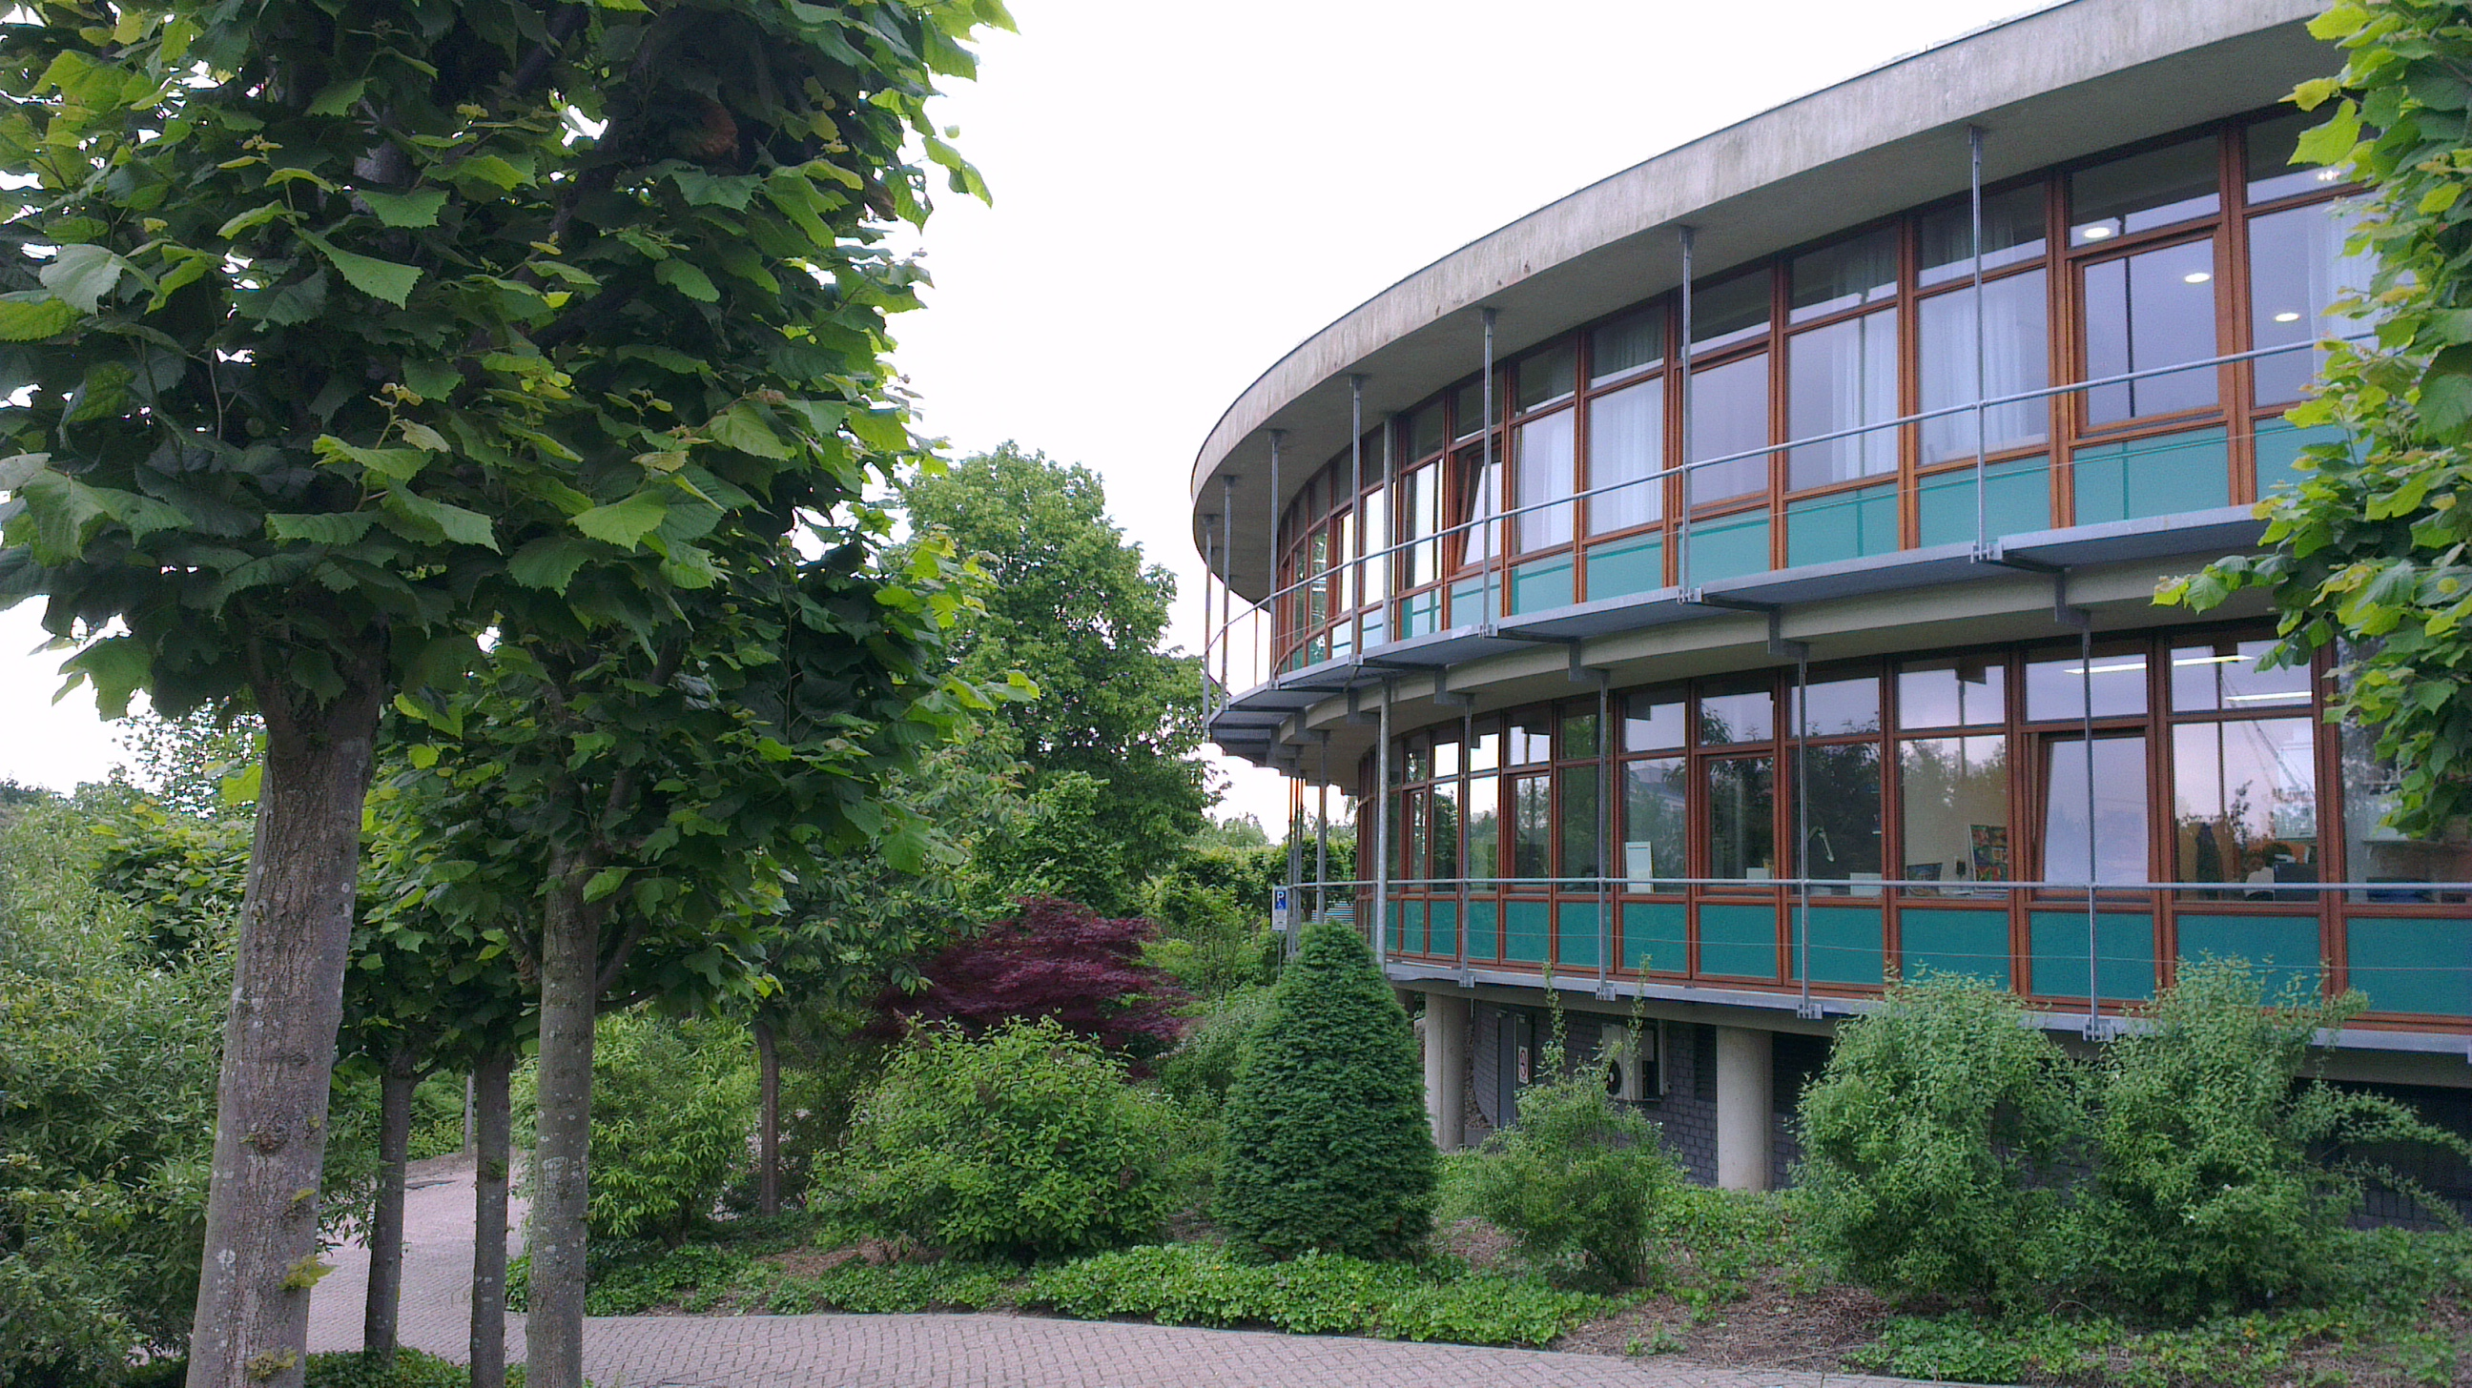
Ankle joint distraction in haemophilia
Lize van Vulpen, MD, PhD
Internist-hematologist
Center for Benign Haematology, Thrombosis and Haemostasis, Van Creveldkliniek
Utrecht, the Netherlands

Slide 2
Disclosures
The prospective study is supported by
the WFH clinical research grant
and an unrestricted grant from CSL Behring,
both paid to the institution

Slide 3
Outline of this presentation
Introduction
Is hemophilic arthropathy still a problem?
Ankle joint distraction
Principle
Retrospective results in haemophilia
Prospective results in haemophilia

Slide 4
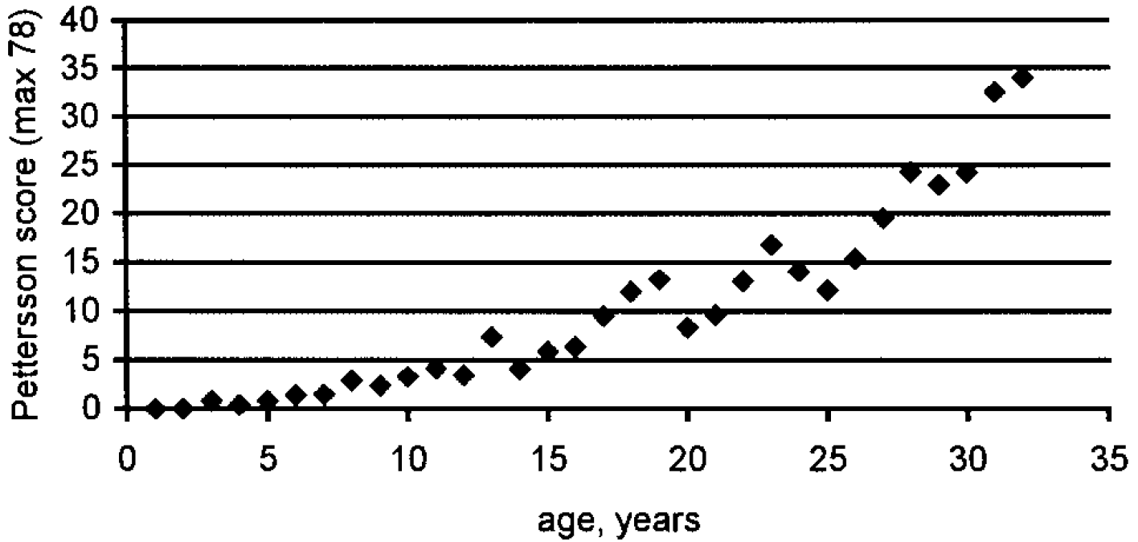
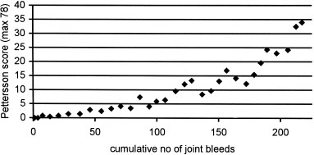
Joint damage in haemophilia
n=117
Severe haemophilia
Fischer et al, Acta Radiologica 2002
Notes:
In order to quantify the effect of the cumulative number of joint bleeds on the Pettersson score, a study was performed using 295 Pettersson scores obtained in 117 patients with severe haemophilia. The patients were born between 1965 and 1994, and had no history of inhibitors. The number of joint bleeds was determined annually from the entry in the clinic and onwards. The localization of bleeds was not assessed. The patients entered the clinic at a median age of 3.6 years, and received intermediate dose prophylaxis, starting at a median age of 5.3 years. Evaluation of 1643 treatment years showed a mean of 6.8 joint bleeds/year. Pettersson scores were obtained at a mean age of 15.9 years (range 1.7-32.9) and had a median value of 4 points (range 0-50).
The Pettersson scores began to rise after the age of 5 years and increased with one point for every 13 joint bleeds (95% confidence interval 11-15). No evidence was found of 'autonomous' progression of Pettersson scores, independent of bleeds.

Slide 5
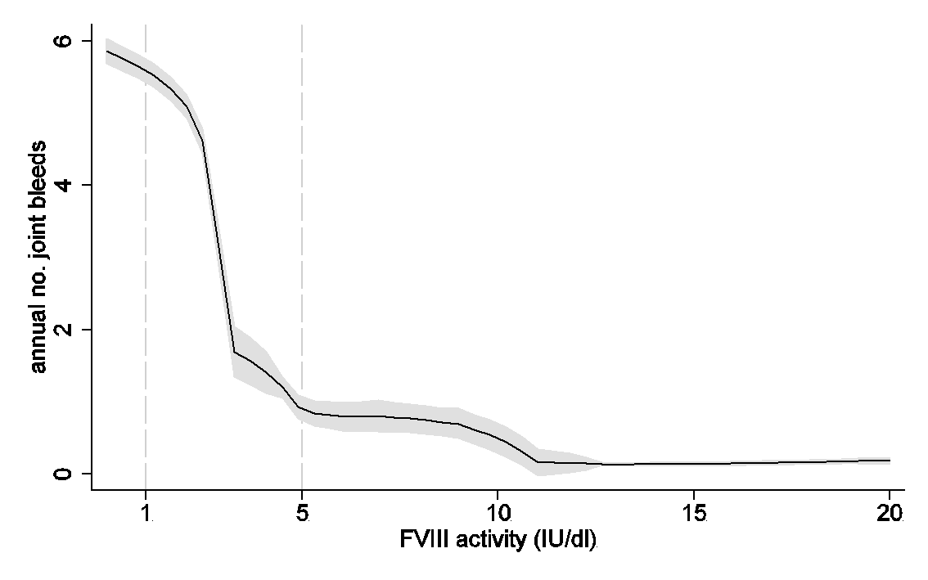
Number of joint bleeds depending on FVIII activity
Den Uijl et al, Haemophilia 2011

Slide 6
Joint disease in the future?
Current haemophilia population
Haemophilia in the Netherlands cohort (N = 906)

Slide 7
Joint disease in the future?
Current haemophilia population
Complete prevention by new treatments?

Slide 8
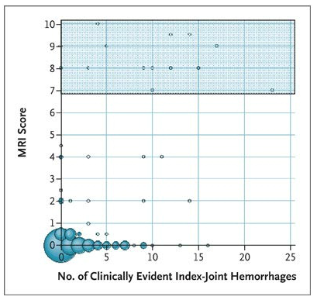
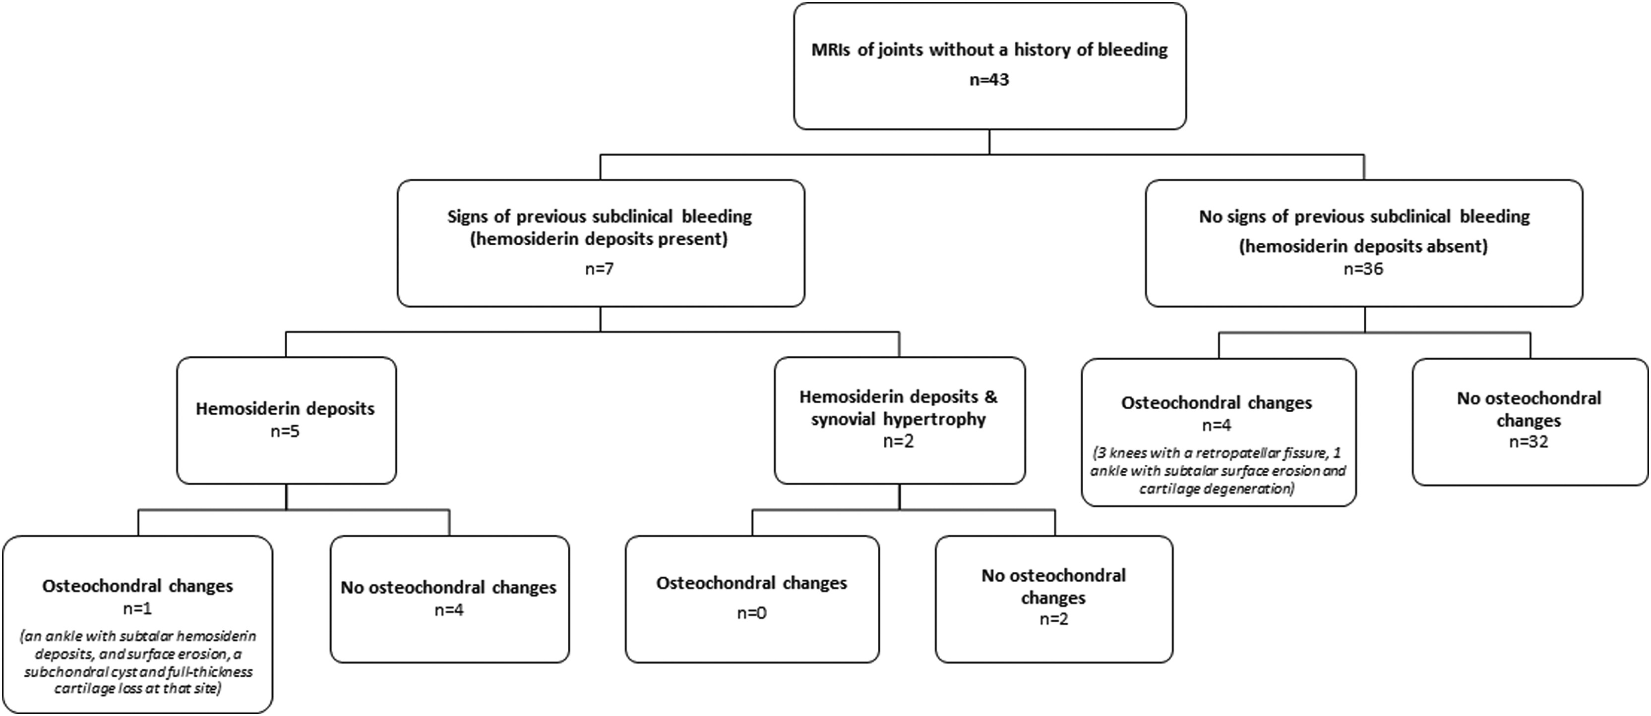
Joint disease in the future?
Current haemophilia population
Complete prevention by new treatments?
Joint disease without clinically overt bleeds
Manco-Johnson et al, NEJM 2007
Kraft et al, JTH 2012
Severe hem A on prophylaxis
Age range 16.5-33.2 years
Van Leeuwen et al, JTH 2023

Slide 9
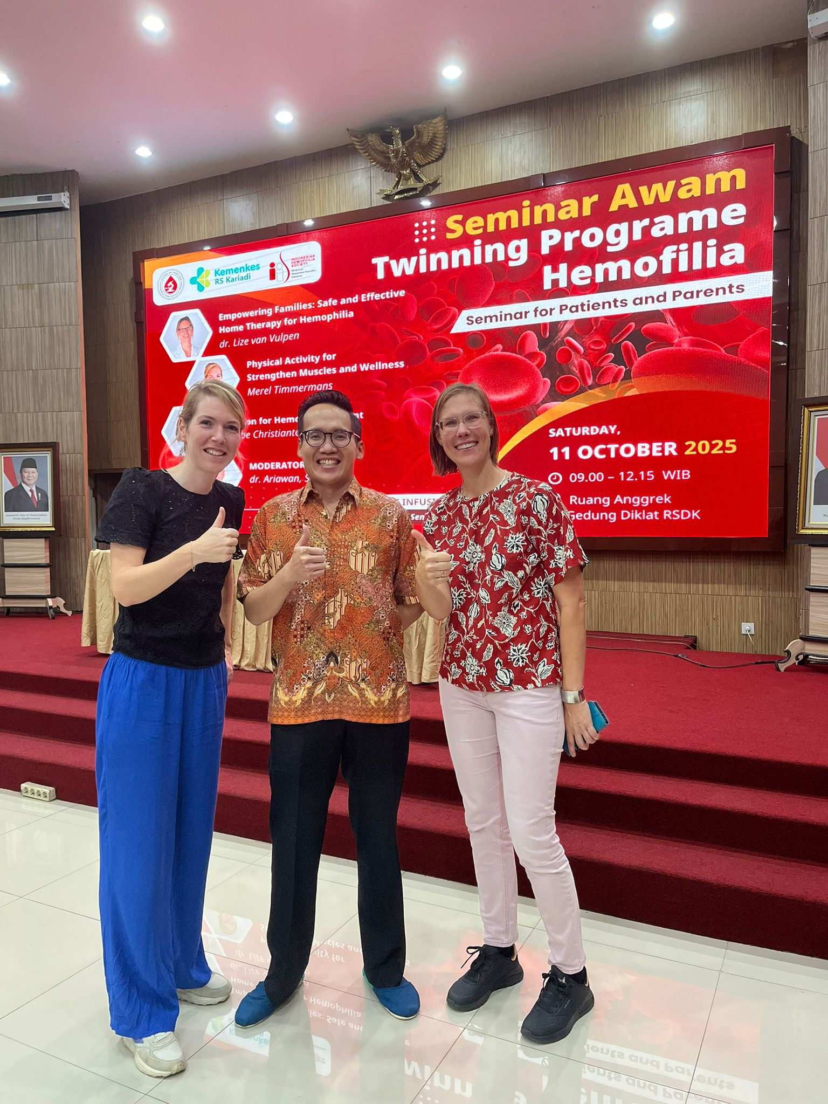
Joint disease in the future?
Current haemophilia population
Complete prevention by new treatments?
Joint disease without clinically overt bleeds
Manco-Johnson et al, NEJM 2007
Kraft et al, JTH 2012
Global differences in treatment availability

Slide 10
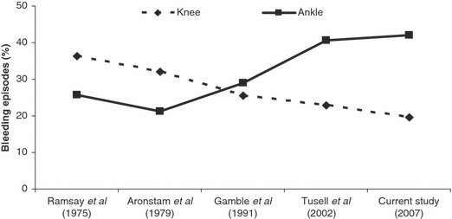
Evolution of joint damage over time
Stephensen et al, Haemophilia 2009

Slide 11
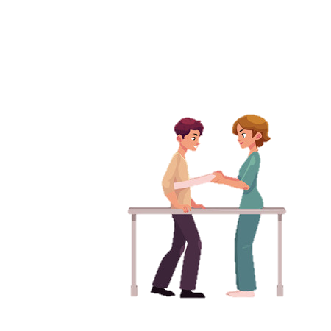
Treatment of joint damage in hemophilia
Prevention: prophylaxis, immediate treatment of bleeds
Analgesics, physical therapy, orthotics
Disease modifying drugs?
Intrinsic tissue repair?
severity of joint damage
Regenerative medicine?
Surgery

Slide 12
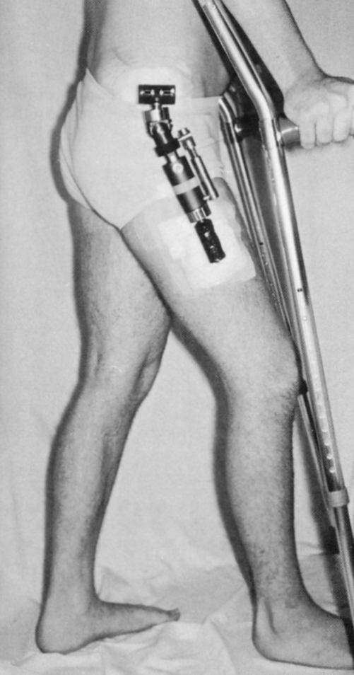
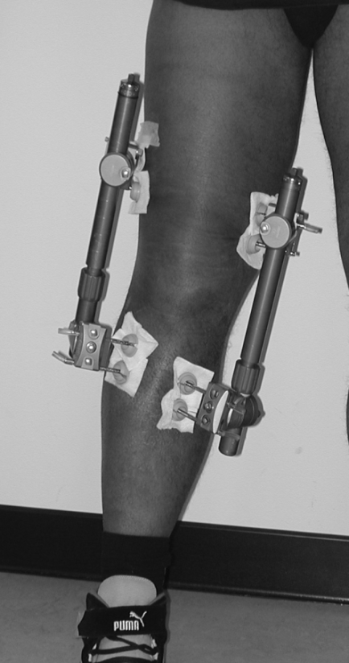
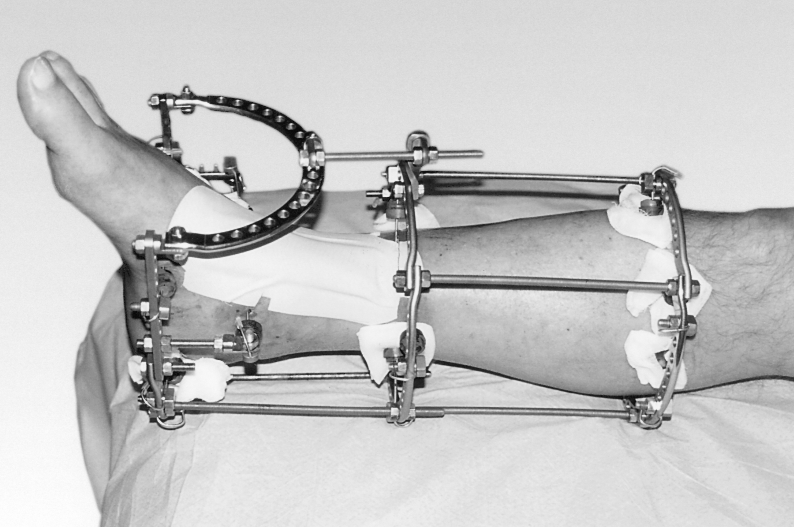
Joint distraction
A surgical procedure in which the two bony ends of a joint are gradually separated to a certain extent for a certain period of time

Slide 13
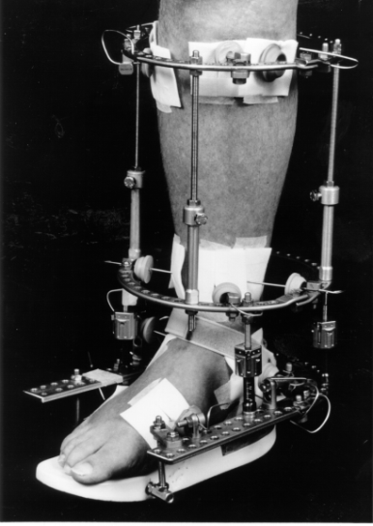
Incentive to evaluate joint distraction in OA
Treatment of equine deformities by actively repositioning the joint
Distraction to prevent damage (compression) of the joint cartilage
In some cases OA was present in the treated joint
unexpected clinical improvement of the OA was observed
Van Valburg et al, J Bone Joint Surg Br 1995
Van Valburg et al, Osteoarthritis Cartilage 1999

Slide 14
Ankle osteoarthritis scale
Pain
Disability
Total
100
90
80
70
60
% of maximum score
50
40
30
20
10
p<0.01
p<0.004
p<0.005
0
before
after joint distraction
before
after joint distraction
before
after joint distraction
73% prolonged clinical benefit
Mean time following distraction: 10±2.5 years, range 7-15 years
Ploegmakers et al, Osteoarthritis Cartilage 2005

Slide 15
Ankle distraction in OA
Flexion
Average JSW (joint space width)
3.5
100
3.0
80
2.5
60
2.0
% of contra-lateral
JSW (mm)
40
1.5
1.0
20
0.5
0
0.0
0
2
4
6
8
10
Control
0
1
2
3
4
5
follow-up (years)
follow-up (years)
Marijnissen ACA et al, Arthritis Rheum 2002
Ploegmakers et al, Osteoarthritis Cartilage 2005

Slide 16
External fixators in haemophilia patients
Indications
Distraction - contractures
Arthrodesis of infected joints
Treatment of open fractures
Kumar et al, Arch Orthop Trauma Surg 2010;
Lee et al, Haemophilia 2004;
Balci et al, Haemophilia 2014

Slide 17
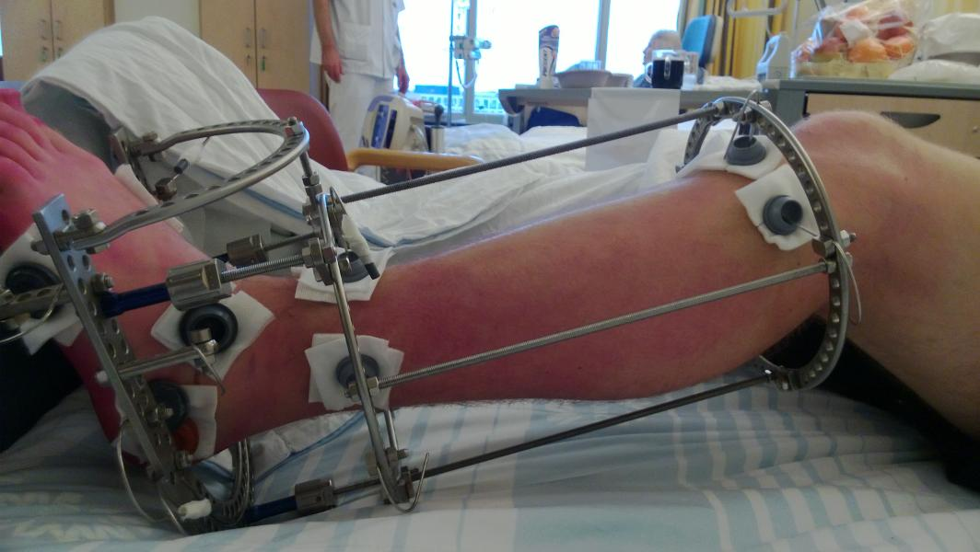
Joint distraction in haemophilia
Case | Age at time of distraction | Haemophilia | Treatment | Affected ankle | Distraction (weeks) | Follow-up (months)
1 | 18 | A, <1% | Prophylaxis | Left | 15 | 48
2 | 33 | B, 2% | On demand | Left | 10 | 32
3 | 29 | A, 10% | On demand | Left | 10 | 26
Van Meegeren et al, Haemophilia 2012

Slide 18
Clinical benefit
Mean (n=3)
Case 1-3
100
*
100
*
*
80
75
60
HAL score (%)
Pain (%)
50
40
25
20
0
0
upper
lower basic
lower complex
sum
pre
post

Slide 19
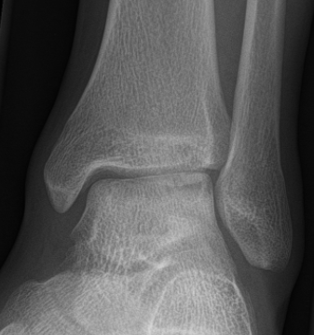
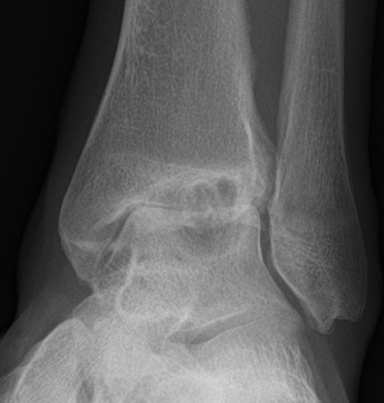
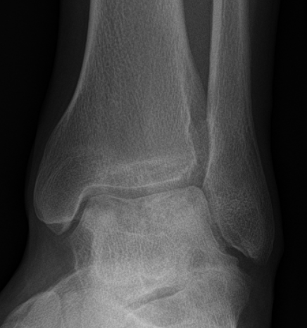
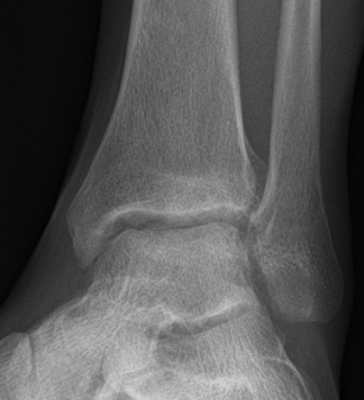
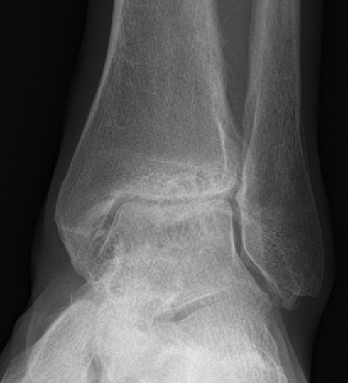
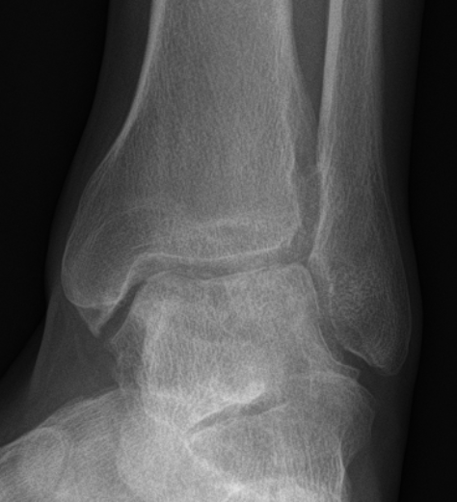
Joint distraction in haemophilia
case 1 (48 mths)
case 2 (32 mths)
case 3 (26 mths)
pre-treatment
3.5 mm
0.3 mm
3.2 mm
post-treatment
4.4 mm
2.0 mm
3.9 mm
(average JSW in mm)

Slide 20
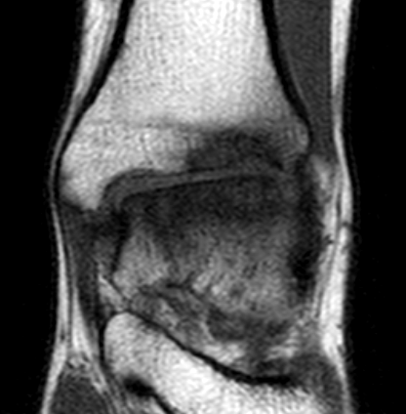
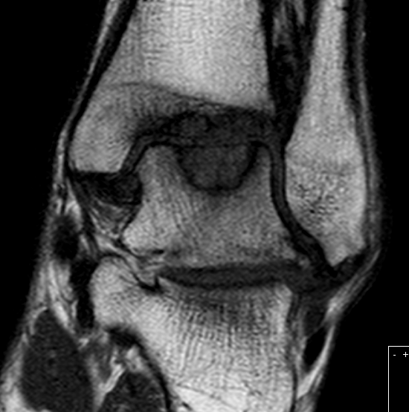
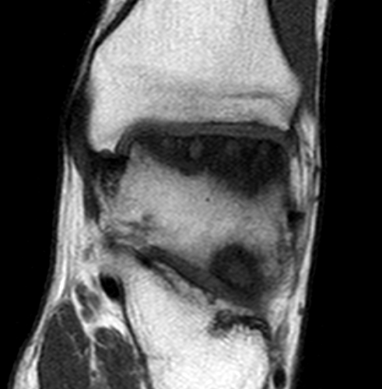
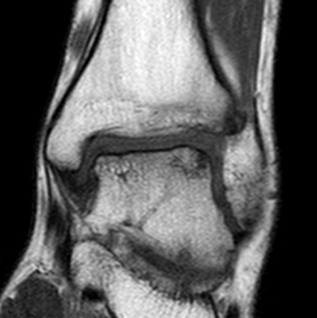
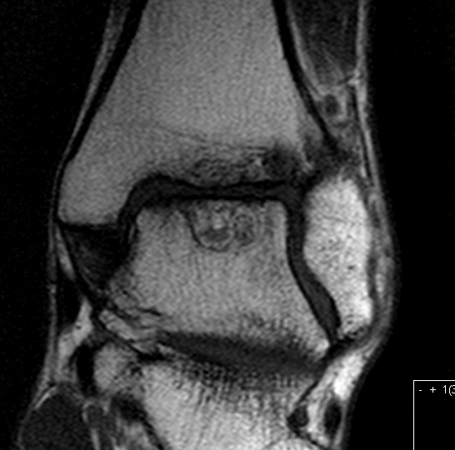
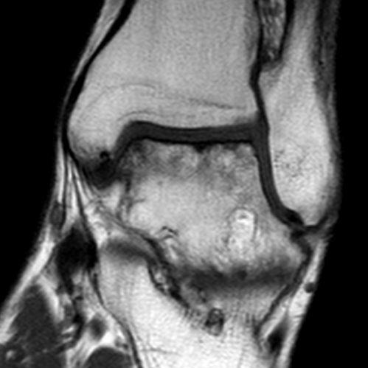
Joint distraction in haemophilia
case 1 (48 mths)
case 2 (32 mths)
case 3 (26 mths)
pre-treatment
post-treatment

Slide 21
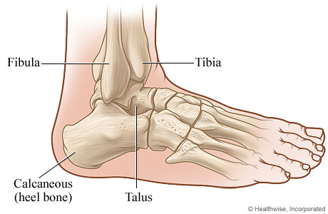
Prospective pilot study
≥18 and <55 yr with haemophilic ankle arthropathy
Tibiotalar joint
Conservative treatment
Functional limitations
10 weeks distraction
10 yr follow-up

Slide 22
Short-term prospective results
Case | Age at time of distraction | Haemophilia | Treatment | Affected ankle | Nettoyage | Follow-up (months)
1 | 21 | B, <1% | OD | Left | No | 36
2 | 25 | A, <1% | PL | Right | No | 36
3 | 32 | A, <1% | PL | Right | No | 24
4* | 33 | A, <1% | PL | Left | No | 36
5 | 21 | A, <1% | PL | Left | No | 36
6 | 45 | A, 2% | OD | Left | Yes | 36
7 | 53 | A, <1% | PL | Left | Yes | 36
8* | 38 | A, <1% | PL | Right | Yes | 36
Van Bergen et al, Haemophilia 2022

Slide 23
Clinical benefit

Slide 24
Clinical benefit
 | Baseline | After 1 yr | After 3 yr
Range of motion | 39° (30°-50°) | 40° (24°-55°) | 44° (30°-60°)
Figure 8 at preferred speed (seconds) | 15.37 (13.33-17.79) | 14.04 (11.95-14.95) | 13.51 (12.03-15.50)
Figure 8 at maximum speed (seconds) | 10.90 (10.59-12.61) | 10.30 (8.79-11.81) | 10.50 (8.37-11.37)
Walking Test 50 meter (seconds) | 33.73 (30.06-37.30) | 28.86 (27.15-34.40) | 30.50 (27.13-31.70)
6 Minutes Walking Test (meter) | 552.50 (440-560) | 573.50 (515-652.50) | 570 (525-605)

Slide 25
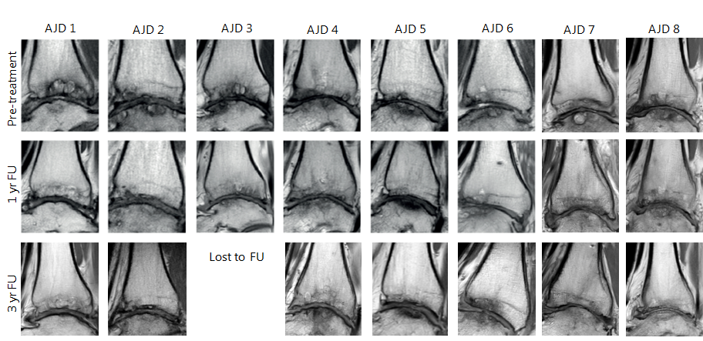
Structural benefit

Slide 26
Long-term follow up retrospective patients
Follow up 11.6-12.9 years after distraction
 | Pre-distraction | 1.7-3.4 y FU | 11-13y FU
Pain score (0-10) | 8.0 | 2.3 | 4.0
HAL lower extr basic | 19.0 | 58.0 | 61.0
HAL lower extr complex | 26.0 | 60.0 | 54.7
Van Bergen et al, Haemophilia 2022

Slide 27
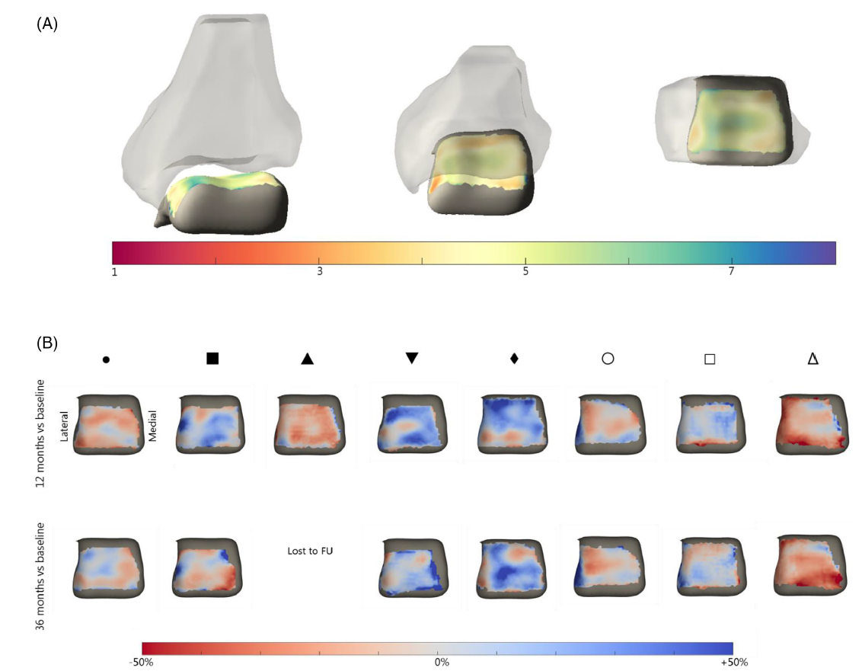
Structural changes
Van Bergen et al, Haemophilia 2022

Slide 28
Structural changes and clinical improvement
Individual biochemical markers showed no clear trend.
No clear correlations between structural changes and clinical improvement
Van Bergen et al, Haemophilia 2022

Slide 29
Conclusion
Ankle joint distraction seems a promising alternative in (young) patients
with severe haemophilic ankle arthropathy postponing the need for ankle
arthrodesis
At present, factors predicting a satisfying clinical response are lacking

Slide 30
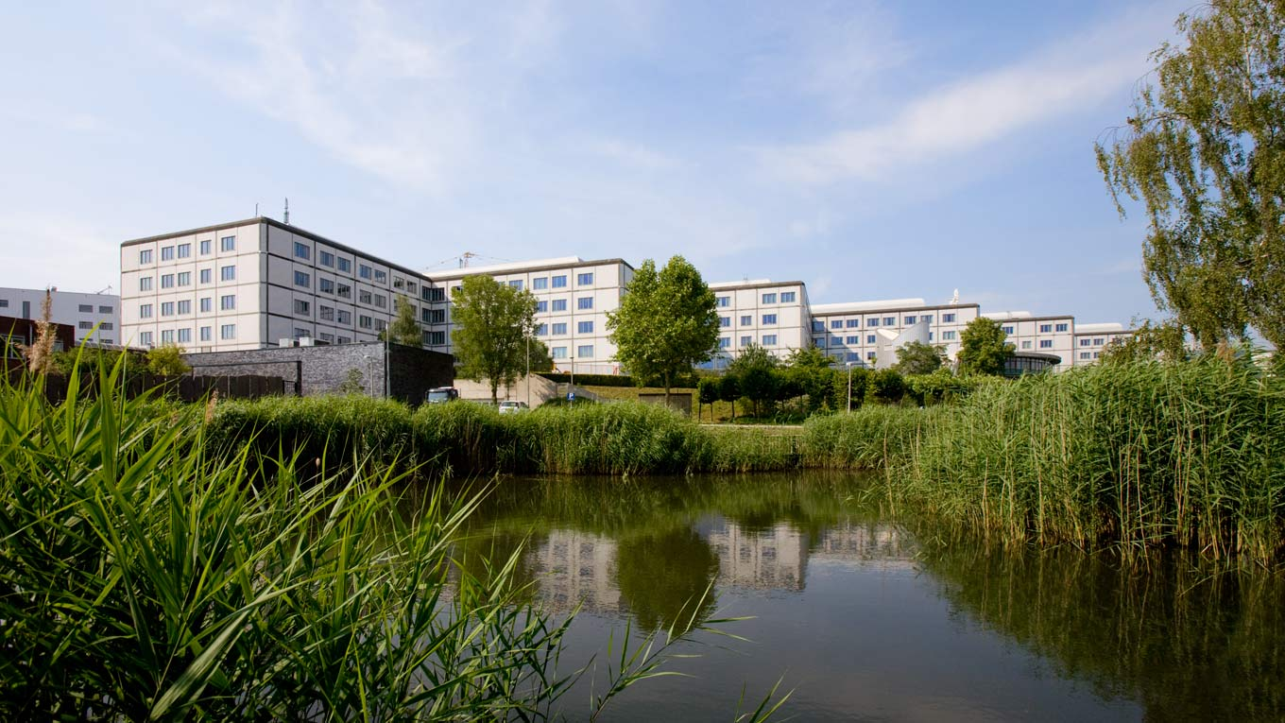
Acknowledgements
Van Creveldkliniek
Prof. dr. R.E.G. Schutgens
Dr. G. Roosendaal
Dr. E.P. Mauser-Bunschoten
P. de Kleijn
Rheumatology & Clinical Immunology
Dr. S.C. Mastbergen
Prof. dr. F.P.J.G. Lafeber
Dr. M.E.R. van Meegeren
Dr. E.D.P. van Bergen
K. Coeleveld
A.N. Concepcion
M.J.G. Wenting – van Wijk
Orthopaedics
Dr. H. Ch. Vogely
Dr. P.M. van Roermund

