Slide 1
Laboratory Measurement of Altuvoct® (efanesoctocog alfa)
Anne Riddell
on behalf the UKHCDO Laboratory Working Party

Slide 2
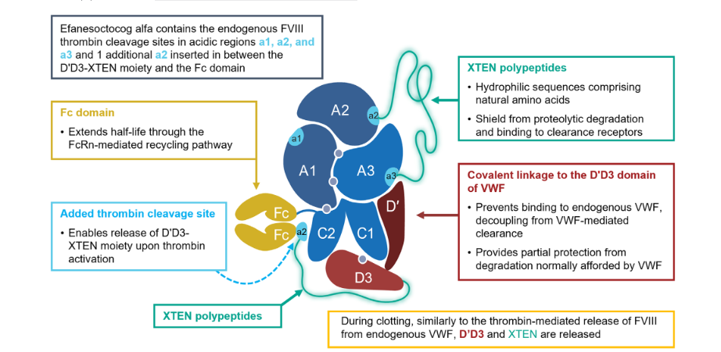
ALTUVOCT® (efanesoctocog alfa, BIVV001)
Pipe S,. Haemophilia. 2024 Jan;30(1):214-223. doi: 10.1111/hae.14831
Notes:
Altuvoct is a rFVIII fusion protein that circulates independent of endogenous VWF.
The molecule contains a triple modification resulting in a unique fusion protein consisting of a:
VWF-D'D3 domain fused to one immunoglobulin-G1 Fc domain,
B-domain deleted FVIII fused to the second Fc domain,
2 XTEN polypeptides to slow degradation and clearance

Slide 3
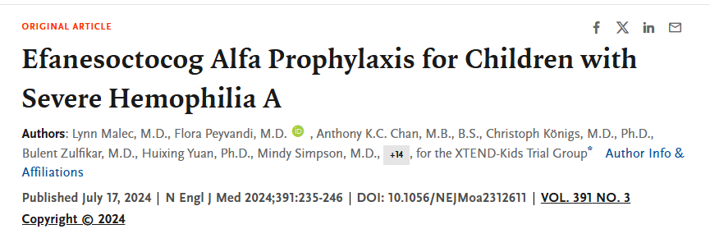
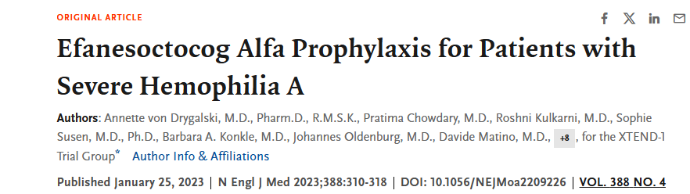
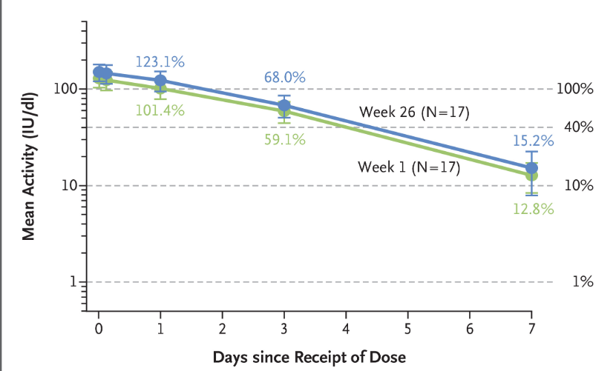
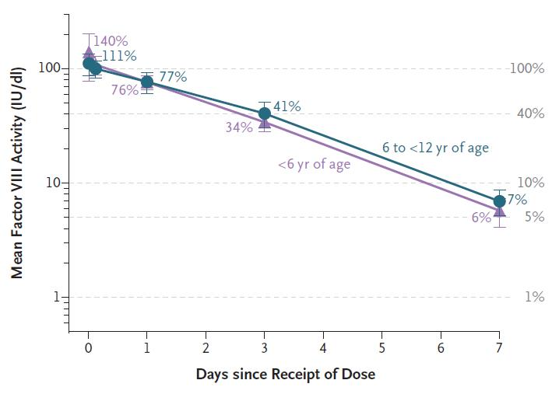
In the UK, ALTUVOCT (efanesoctocog alfa) is indicated for the treatment and prophylaxis of bleeding in patients 2 years and above with severe or moderate haemophilia A (≤5% endogenous plasma factor VIII activity).
In Ireland, ALTUVOCT (efanesoctocog alfa) is indicated for the treatment and prophylaxis of bleeding in patients with haemophilia A (congenital factor VIII deficiency). ALTUVOCT can be used for all age groups.
Notes:
During Efa development, including the pivotal phase III trial, FVIII activity was measured using an OSA with Actin FSL reagent (Siemens Healthcare).

Slide 4
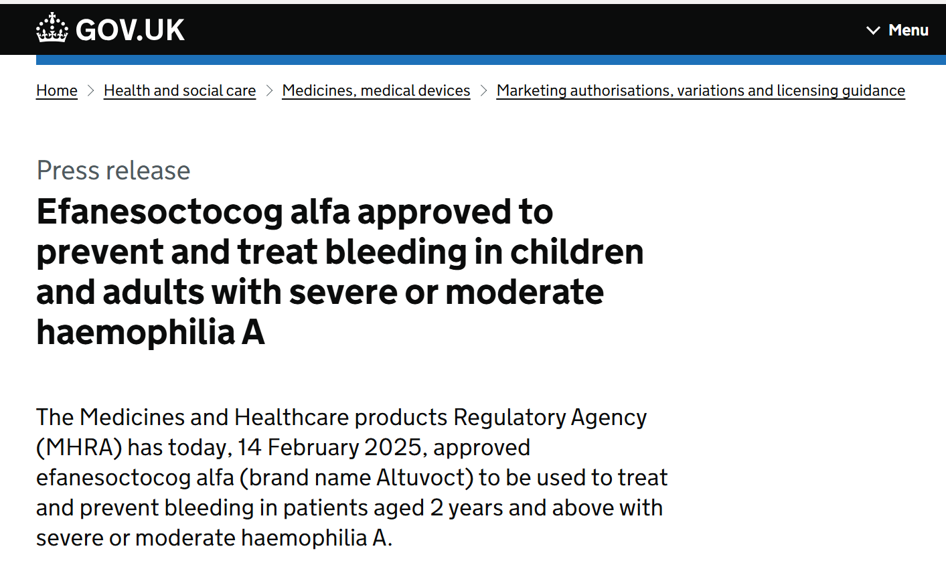
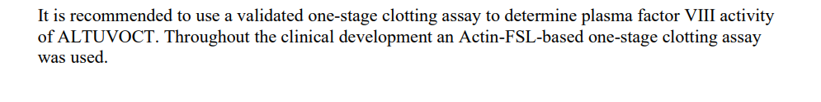
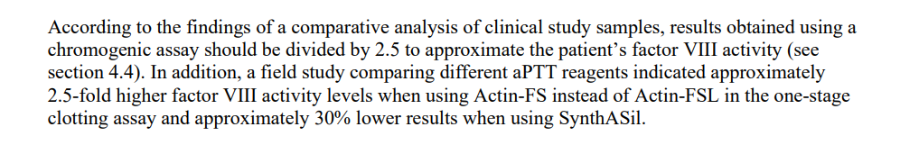
Summary of Product Characteristics (SmPC) ^{1&2}
Efanesoctocog alfa approved to prevent and treat bleeding in children and adults with severe or moderate haemophilia A - GOV.UK
ALTUVOCT EU Summary of Product Characteristics. 2. ALTUVOCT UK Summary of Product Characteristics

Slide 5
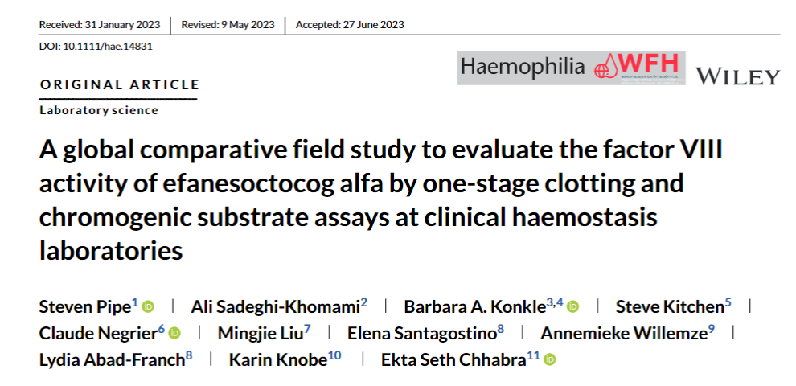
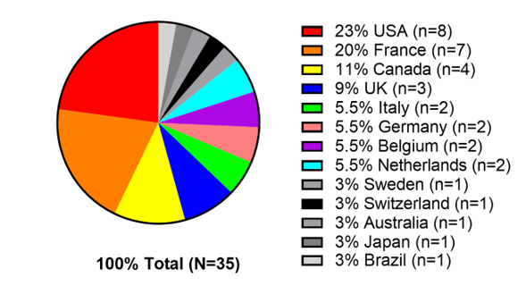
Frozen plasma spiked to 80, 20, 5 IU/dL efanesoctocog alfa (EFA) or octocog alfa
Potency of EFA samples confirmed by OSA using Actin FSL and WHO 8th Concentrate standard
Participating Labs used local FVIII assays and calibrators
51 OSA (one-stage FVIII, 14 APTT reagents)
42 CSA (chromogenic FVIII, 8 kits)
Acceptability recovery target FVIII was set at ±25% in this study
Taken from https://onlinelibrary.wiley.com/doi/10.1111/hae.14831)
Notes:
To explore assay differences a global field study was distributed and published in January 2023

Slide 6
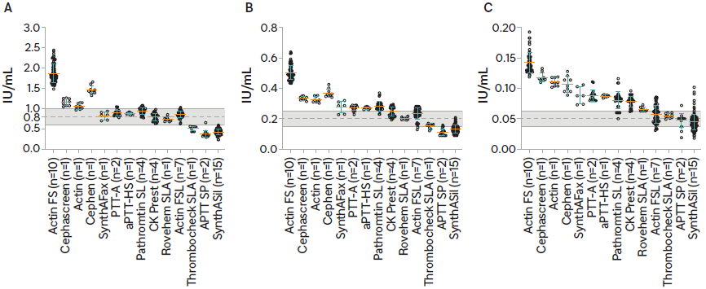
Altuvoct (efanesoctocog alfa): One-Stage (OSA) FVIII:C
Pipe S,. Haemophilia. 2024 Jan;30(1):214-223. doi: 10.1111/hae.14831
Notes:
Grey areas are +/- 25% nominal activity
The results from a global laboratory field study were published in January 2024 (Pipe, Haemophilia;2024;30;1;214-23).
Data was returned using OSA with14 different APTT reagents; the mostly common being Synthasil, Actin FS and Actin FSL, and 8 different CSA.
The range for accurate measurement was +/-25% of the expected target at each concentration studied. OSA using Actin FSL recovered within 25% of expected target. OSA using Actin FS overestimated by more than 200%, OSA with Synthasil underestimated by 30-40%. Other APTT reagents that may be acceptable for use were reported by 1-4 labs, more data are required to confirm these findings.

Slide 7
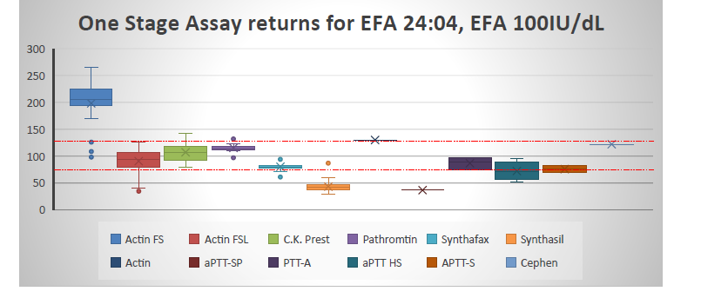

Plasma spiked at 0.05, 0.20, 0.50, 1.00 IU/ml efanesoctocog only
Plasma spiked with 0.50/1.00 IU/ml efanesoctocog plus 20/50 ug/ml emicizumab
200 European centres returned results
UKNEQAS EFANESOCTOCOG ALFA EXERCISE 2024- USED WITH PERMISSION
1. Reilly-Stitt et al, Efanesoctocog alfa FVIIIC measurement exercise between NEQASBC and ECAT. EAHAD 2025.

Slide 8
FVIII One-Stage Assay -summary
Only Actin FSL FVIII OSA results were acceptable (±25%) at all FVIII levels (0.8/0.2/0.05 IU/mL)
Other OSAs : acceptable recovery with SynthAFax, Revohem SLA, Pathromtin SL, PTT-A, aPTT-HS, CK Prest at 0.80 IU/ml
HemosIL Synthasil (Werfen) : underestimation 30-40% at 0.80/0.20 IU/ml
Actin FS (Siemens) : overestimation 225-285% at all concentrations
Pipe S,. Haemophilia. 2024 Jan;30(1):214-223. doi: 10.1111/hae.14831

Slide 9
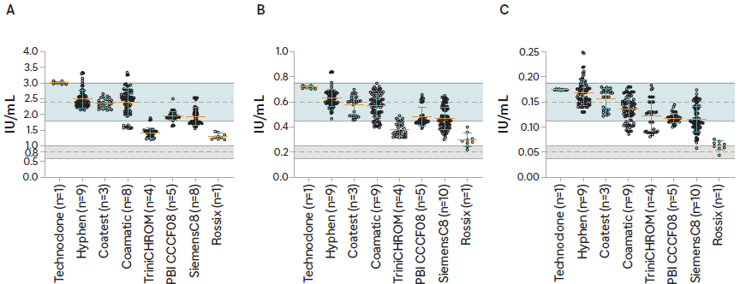
Altuvoct (efanesoctocog alfa): FVIII Chromogenic Assay (CSA)
Pipe S,. Haemophilia. 2024 Jan;30(1):214-223. doi: 10.1111/hae.14831
Notes:
Target range highlighted in grey
The degree of overestimation varied between kits; Trinichrom and Rossix demonstrated approximately 130-180% recovery whilst other CSA recovered more than 200%.

Slide 10
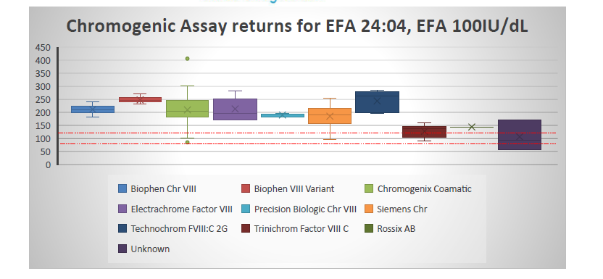
UKNEQAS EFANESOCTOCOG ALFA EXERCISE 2024- USED WITH PERMISSION

Slide 11
FVIII Chromogenic Assay -summary
Overestimation with all CSA- average 265-271% across concentrations.
But… variation between kits
TriniCHROM overestimation 180-190% at 0.80/0.20 IU/ml but 250% at 0.05 IU/ml
Rossix overestimation 130-160%
Pipe S,. Haemophilia. 2024 Jan;30(1):214-223. doi: 10.1111/hae.14831

Slide 12
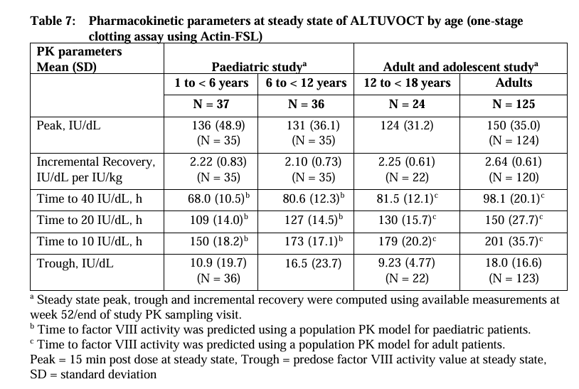
SmPC – Summary of steady state Altuvoct FVIII:C Levels
https://www.ema.europa.eu/en/documents/product-information/altuvoct-epar-product-information_en.pdf

Slide 13
Measuring Altuvoct FVIII levels in the presence of FVIII mimetics
Emicizumab current licenced FVIII mimetic
Effects of emicizumab on coagulation assays (FVIII OSA and CSA) well documented ¹
Accurate measurement of post SHL and EHL FVIII levels in presence of emicizumab is by using:
FVIII CSA that contains bovine components (FX, FIXa) ¹
Accurate measurement of Altuvoct FVIII levels in the presence of emicizumab has not been evaluated in a trails or in laboratory field studies to date
1. Laboratory coagulation tests and emicizumab treatment A United Kingdom Haemophilia Centre Doctors' Organisation guideline.
Haemophilia. 2020;26:151–155

Slide 14
Summary of product characteristics (SmPC) Altuvoct
1. ALTUVOCT EU Summary of Product Characteristics. 2. ALTUVOCT UK Summary of Product Characteristics

Slide 15
Emicizumab ± rFVIII or Altuvoct (efanesoctocog alfa)
Emi alone
Standard FVIII OSA - do not use^{1.}
Emicizumab calibrated modified OSA - use to measure drug concentration (µg/mL)
Emi
+ rFVIII
Monitor rFVIII (SHL or EHL) with bovine FX CSA ^{1.}
Emi
+ Altuvoct
Standard OSA – do not use
Bovine FX component CSA - to monitor Altuvoct, SMPC recommends divide the result by 2.5 ^{2.}
Human FX CSA- use for emicizumab mimetic effect
Bovine FX CSA- insensitive to emicizumab
Laboratory must be informed if the patient is on Emicizumab and Altuvoct
1. Laboratory coagulation tests and emicizumab treatment A United Kingdom Haemophilia Centre Doctors' Organisation guideline. Haemophilia. 2020;26:151–155.
2..ALTUVOCT UK Summary of Product Characteristics
Notes:
in summary labs would need to use a CSA to measure treatment Altuvoct levels is when patients are also treated with Emicizumab

Slide 16
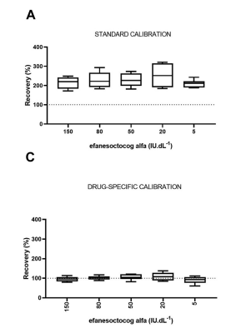
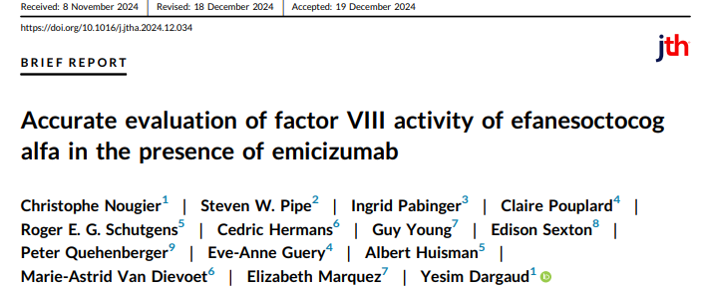
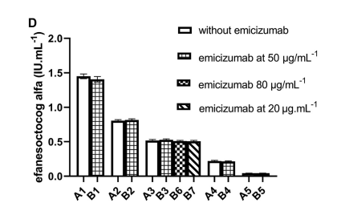
Product specific calibrator-proof of concept
Clinical labs - Europe (N=5), USA (N=2). Bovine FVIII CSA kits (N=3 types). Analysers (N=4 types)
10 samples with EFA (150, 80, 50, 20 and 5 IU/dL) ± Emicizumab (50µg/mL) (A & B samples)
1 sample with EFA (50 IU/dL) +Emicizumab (80µg/mL)
1 sample with EFA (50 IU/dL) +Emicizumab (20µg/mL)
Calibrators used: SHP (Siemens), Product specific Calibrator made by spiking Altuvoct into FVIII deficient to 100 IU/dL
Conclusion: Use of an Altuvoct (EFA) calibrator allowed precise measurement of ‘spiked’ EFA FVIII levels ±emiczumab¹
Notes:
Late last year this paper was published by Drs Nougier et al
A samples contain EFA only at 5-150 u/dl
B plasmas same but with emi 50 ug/mL
Panel A recovery of efa only samples with standard plasma calibration curve in a bovine CSA – over estimation
Panel C CSA with drug specific calibration curve for the A samples displaying interlaboratory variability (Drug sp cal ranged from% CV 9 – 18)
Panel D CSA with drug specific calibration curve plus or minus emi
Concluded their study highlighted the necessity for a commercially available product specific calibrator for EFA to minimise variability. NOT been validated in patients

Slide 17
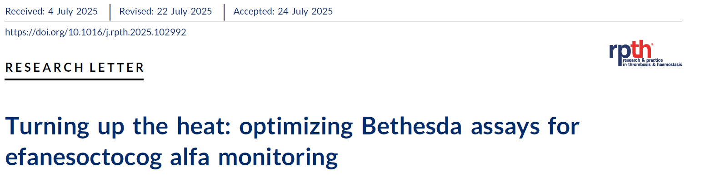
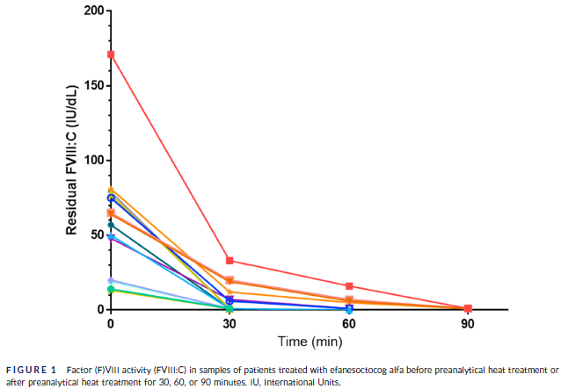
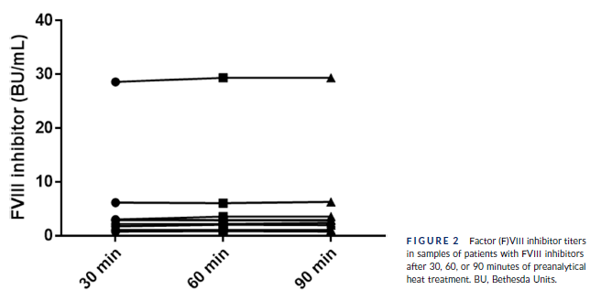
Monitoring for FVIII inhibitors in patients treated with Altuvoct
Current pre heat treatment (PHT) protocol for samples being used in a Bethesda or Nijmegen Bethesda assay is the WFH recommended method of 56◦C for 30 minutes¹
Dr Herb et al study of patient samples treated with EFA concluded:
Extended PHT protocols (90 minutes) are required when testing samples in a FVIII Bethesda/Nijmegen Bethesda assay ²
Extended PHT did not compromise the accuracy of inhibitor detection
Srivastava A, Santagostino E, Dougall A, Kitchen S, et al WFH Guideline Haemophilia. 2020;26:1–158.
2. Herb A, Wimmer J, Desprez D et al Res Pract Thromb Haemost. 2025;9:e102992
Notes:
Study by Dr Herb et al from Strasbourg, France,
Screening for FVIII inhibitors will still need to be done on a regular basis
Residual FVIII activity after PHT was measured on a STA-R Max analyzer

Slide 18
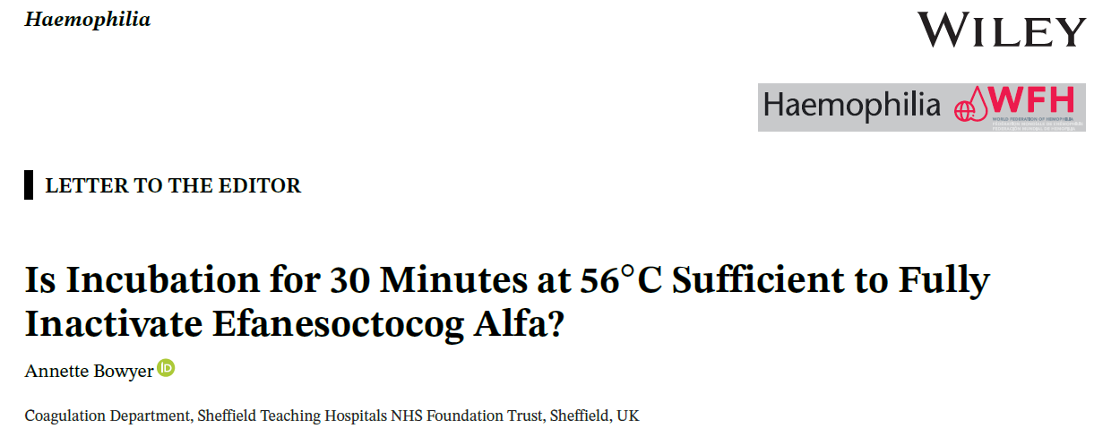
PHT residual FVIII:C levels of plasmas containing EFA (lyophilised NEQAS/ECAT exercise samples) after incubation 56◦C for 30, 60 or 120 showed 30 min was not sufficient & that 120 min was required
60-min PHT incubation at 56◦C destroyed more than 90% of efanesoctocog alfa in frozen plasma
More patient sample data required to confirm findings
ECAT/NEQAS
samples
FR 1–4 frozen SHA plasma (nominally spiked to 100, 80, 20,
5 IU/dL with efa
Haemophilia, 2025; 0:1–3

Slide 19
The laboratory monitoring of Altuvoct (efanesoctocog alfa): Recommendations from the Laboratory Working Party of the UKHCDO (Bowyer A, Khan M., Lawrence C., et. al. in press Haemophilia)
Altuvoct FVIII level test requests for the laboratory essential treatment information is included with sample for testing
FVIII OSA
Suitable APTT reagents: Actin FSL, Synthafax and CK Prest calibrated with a plasma standard (1B)
Unsuitable APTT reagents when calibrated with a plasma standard:
Synthasil & Thrombocheck SLA (underestimate) (1B)
Actin, Actin FS Cephen, Cephascreen (overestimate) (1B)
FVIII CSA
All unsuitable (all over-estimate Altuvoct FVIII levels) when calibrated with a plasma standard (1B)
Use of a correction factor is not recommended (acknowledgement that the SmPC states ‘CSA level can be divided by 2.5 to approximate the Altuvoct FVIII level) (1B)
Laboratories likely will need to verify a suitable FVIII OSAs to measure Altuvoct (this may be different to their current ‘routine’ FVIII OSA)

Slide 20
Laboratory Working Party Recommendations
Measuring Altuvoct in the presence of FVIII mimetics
Post Altuvoct FVIII level can be measured using CSA (bovine FX and bovine FIXa) (1B)
The uncorrected FVIII CSA result should be reported by the laboratory with an additional comment stating ‘level is overestimated 1.5 – 3fold’ (1B)
FVIII CSAs that use human FX and FIXa should not be used (1B)
FVIII CSAs that use bovine FX and human FIXa require local validation before measuring Altuvoct activity in the presence of FVIII mimetics (1C)

Slide 21
Laboratory Working Party Recommendations
Measuring FVIII Inhibitors in patients on Altuvoct
Samples require a pre heat treatment (PHT) step prior to use in the FVIII Bethesda or Nijmegen Bethesda assay (1B)
Extended PHT 60 – 120 minutes to remove Altuvoct FVIII from the sample (no need to change APTT reagents)
Measuring FVIII Inhibitors in patients in the presence of Altuvoct and FVIII mimetic (emicizumab)
Pre heat treatment step required as above prior to using in a CSA (bovine FX and FIXa) FVIII Bethesda or Nijmegen Bethesda assay (1B)

