Slide 1

Bleeding assessment tool: For
Dr Will Thomas
1st November 2023

Slide 2
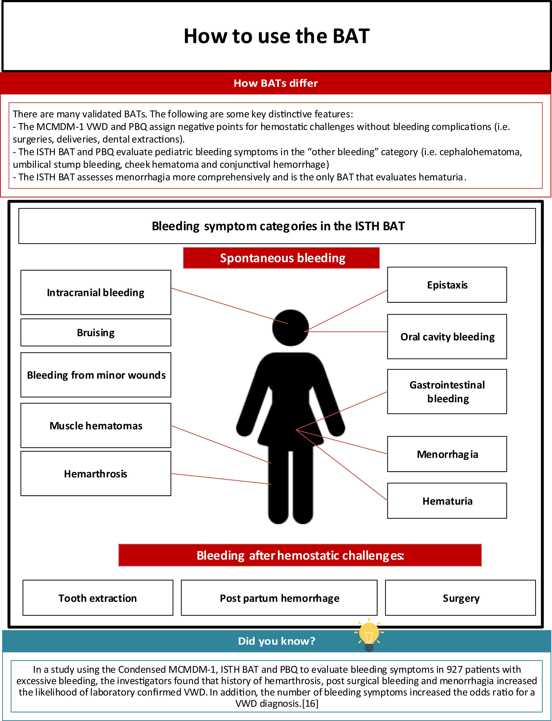
Flagging up different bleeding domains
Elbaz et al, 2021, RPTH, 4, 761-773.

Slide 3
Can discern platelet disorders/VWD v normal
 | Vicenza BAT | Condensed MCMDM-1 VWD BAT | PBQ | ISTH BAT | Self BAT
Sensitivity of a normal score to rule out the diagnosis of VWD | 69% | 100% | 83% | 64% | 78%
Specificity of an abnormal score to rule in the diagnosis VWD | 98% | 87% | 79% | 99% | 23%
Gresele et al. JTH. 2020; 18:732-739.
Elbaz et al. RPTH. 2021; 4: 761-773.

Slide 4
Deciding on investigation
Tests | When to perform
Full blood count and film, clotting screen including fibrinogen, von Willebrand factor, platelet function tests (PFA-100 or light transmission aggregometry) | Baseline tests
Von Willebrand factor genetics, collagen binding and multimers | If low von Willebrand factor levels found
Coagulation factors | If the clotting screen abnormal
Further platelet studies (nucleotides, genetics, release assays, flow cytometry) | If a platelet disorder suspected
FXIII, chromogenic FVIII, α-2 antiplasmin, PAI-1 | Delayed surgical bleeding
PAI-1, plasminogen activator inhibitor-1.
Adapted from Hayward CPM. Int J Lab Hematol. 2018 May;40 Suppl 1:6-14.
Notes:
Strategy used to guide bleeding disorder diagnosis. This figure (which revises our previous scheme, published in ) summarizes the author's current recommendations for the initial investigations of a suspected bleeding disorder and the subsequent investigations that should be considered to confirm the diagnosis or to further evaluate the cause, based on initial test findings. TT, thrombin time; VWD, von Willebrand disease; VWF, von Willebrand factor
IF THIS IMAGE HAS BEEN PROVIDED BY OR IS OWNED BY A THIRD PARTY, AS INDICATED IN THE CAPTION LINE, THEN FURTHER PERMISSION MAY BE NEEDED BEFORE ANY FURTHER USE. PLEASE CONTACT WILEY'S PERMISSIONS DEPARTMENT ON PERMISSIONS@WILEY.COM OR USE THE RIGHTSLINK SERVICE BY CLICKING ON THE 'REQUEST PERMISSIONS' LINK ACCOMPANYING THIS ARTICLE. WILEY OR AUTHOR OWNED IMAGES MAY BE USED FOR NON-COMMERCIAL PURPOSES, SUBJECT TO PROPER CITATION OF THE ARTICLE, AUTHOR, AND PUBLISHER.

Slide 5
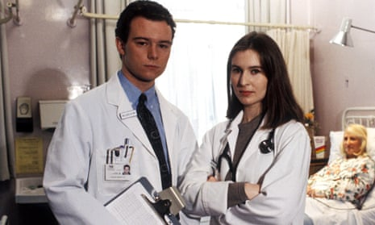
Helping more junior staff

Slide 6
Other benefits
Quickly conveys information
Objective (ish)
Can be used for research purposes
Standardises assessment in clinics

Slide 7
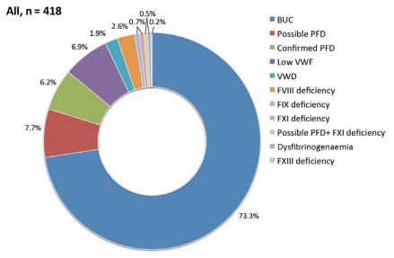
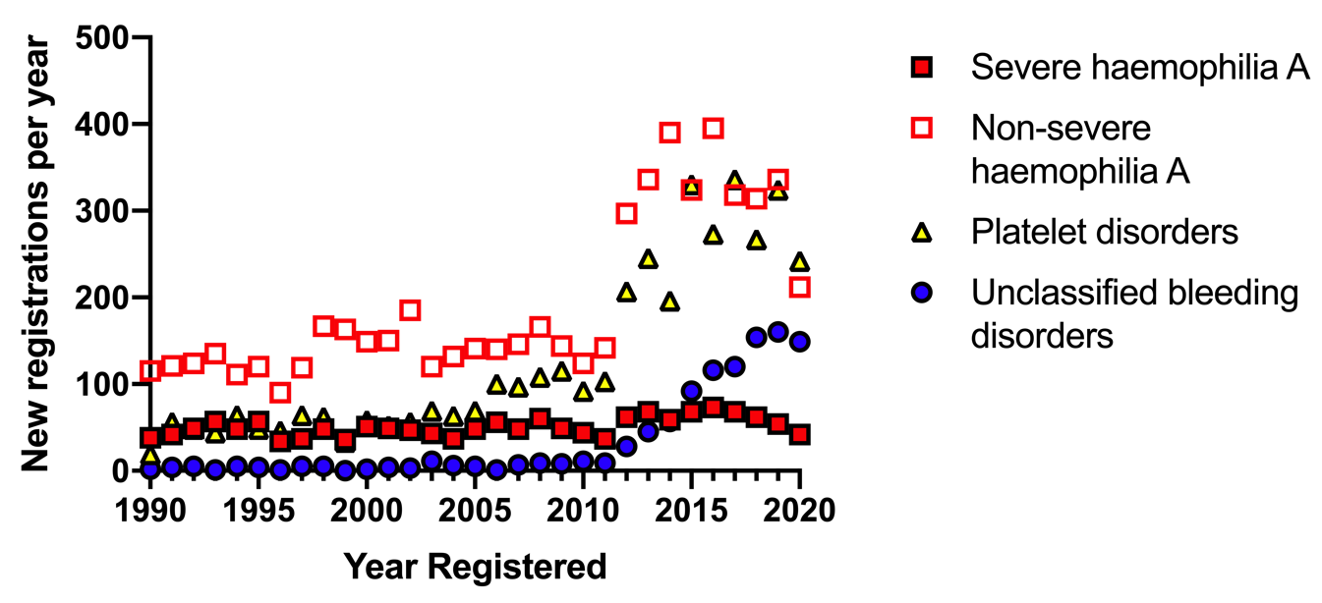

Finally….
Bleeding disorder of unknown cause (BDUC)
Convincing bleeding history but normal laboratory tests of haemostasis
Common conundrum in clinical practice
2.65% registrations in 2019 with UKHCDO had UBD
Gebhart et al, Haemophilia, 2018. Thomas et al, JTH, 2021. Obaji et al, Haemophilia, 2016. Thomas et al, Haemophilia, 2020.

