Slide 1
Hepatology and Haemophilia
Stuart McPherson
Consultant Hepatologist
Liver Unit, Freeman Hospital, Newcastle upon Tyne
Translational and Clinical Research Institute, Newcastle University.

Slide 2
Overview of talk
Brief overview of epidemiology and natural history of liver disease
How to identify and stage liver disease
Overview of treatments for steatotic liver disease
Liver effects of adenovirus delivered gene therapy

Slide 3
Mortality from liver disease is rising
Mortality from Major Disease
Mortality from liver disease in under 75s
Liver disease
Williams et al Lancet 2015

Slide 4
Reasons for rising rates of liver deaths
High levels of harmful drinking
Rising obesity rates
Strong association between liver disease and deprivation
Undiagnosed and untreated HCV and HBV
Liver disease is frequently diagnosed late
Williams et al Lancet 2015

Slide 5
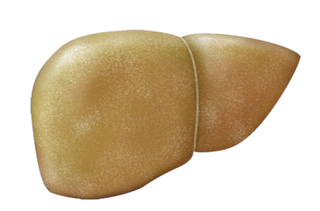
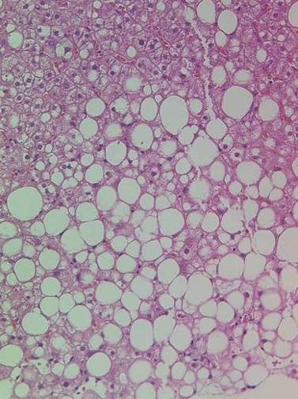
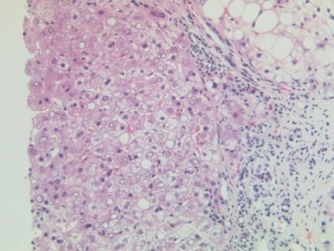
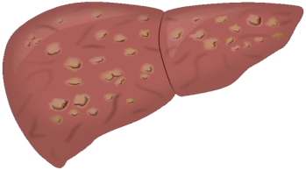
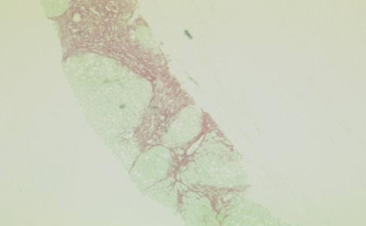
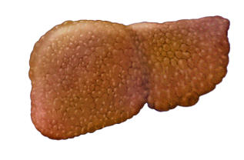
Natural history of steatotic disease
Hepatic steatosis
(fatty infiltration of liver)
25% of UK population
have SLD
Steatohepatitis +/- fibrosis
(fat + hepatocellular injury and inflammation)
20%
?
Major risk factors for progression
Obesity
Type 2 diabetes
Metabolic syndrome
Alcohol consumption
Co-existent liver disease (HCV/HBV)
Cirrhosis
45% risk of
Decompensation
at 10 years
2% risk of
HCC per year
20% mortality
At 10 years

Slide 6
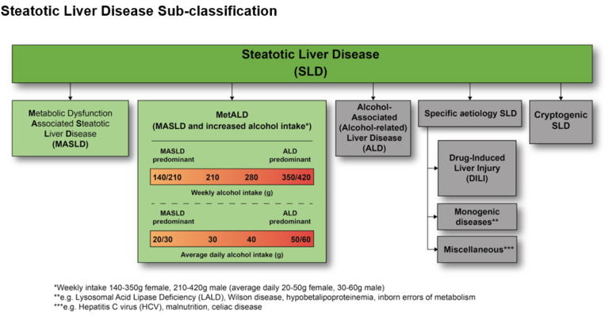
Rinella ME, Lazarus JV, Ratziu V, et al. Hepatology. 2023

Slide 7
High prevalence of steatotic liver disease in people with haemophilia
163 people with moderate to severe haemophilia
had a detailed liver assessment
About half had evidence of steatotic liver disease
Most had normal liver enzymes
Shen M et al. Clinical and Applied Thrombosis/Haemostasis 2022

Slide 8
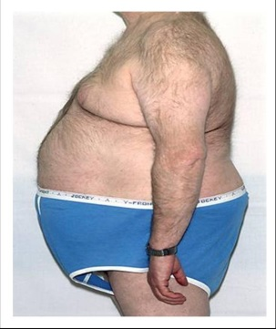
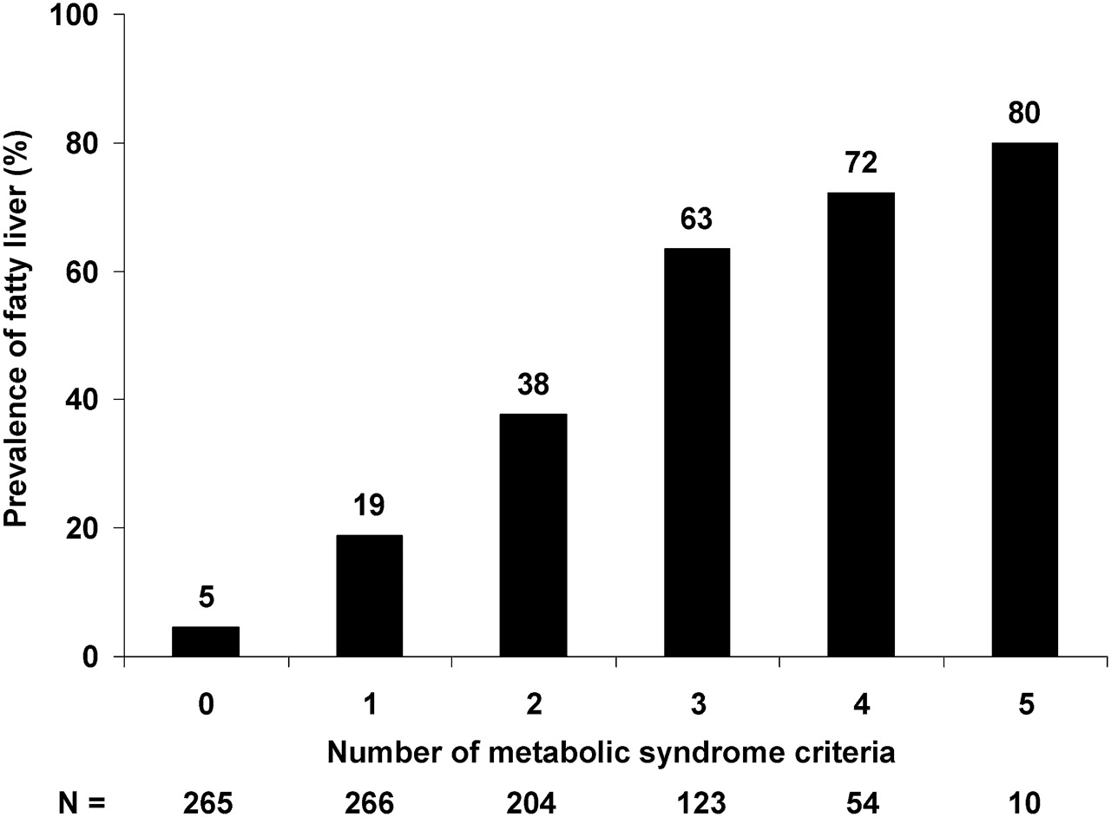
Suspect Steatotic Liver Disease
Who is at risk?
All overweight/obese individuals
Older sedentary individuals
Type 2 diabetics/metabolic syndrome
Harmful alcohol consumption
Often goes undiagnosed
Frequently asymptomatic
Many patients with SLD have normal liver enzymes
Raised liver enzymes inconsistently investigated
Prevalence of fatty liver in the community in individuals with features of the metabolic syndrome

Slide 9
Pragmatic diagnosis of SLD
Raised ALT and/or GGT and evidence of steatosis on imaging
Imaging evidence of steatosis
Raised ALT and/or GGT and evidence of insulin resistance / central obesity / metabolic risk factors
Chalasani N et al Gastroenterology 2012; 142: 1592

Slide 10
Pragmatic diagnosis of SLD
Raised ALT and/or GGT and evidence of steatosis on imaging
Imaging evidence of steatosis
Raised ALT and/or GGT and evidence of insulin resistance / central obesity / metabolic risk factors
Document alcohol consumption and categorise accordingly
No known pre-existing liver disease
No hepatotoxic drugs
Negative blood screen for other liver diseases (viral, autoimmune etc)
Chalasani N et al Gastroenterology 2012; 142: 1592

Slide 11
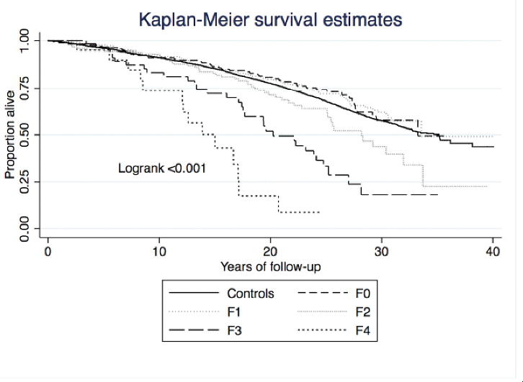
Fibrosis stage is the major predictor of outcomes
Key people to diagnose with SLD
Cirrhosis
Monitor for complications of cirrhosis
Treat to prevent progression
Advanced fibrosis
Treat to prevent progression
Monitor for progression
Moderate fibrosis (in younger people)
Hangtrom J Hepatol 2018

Slide 12
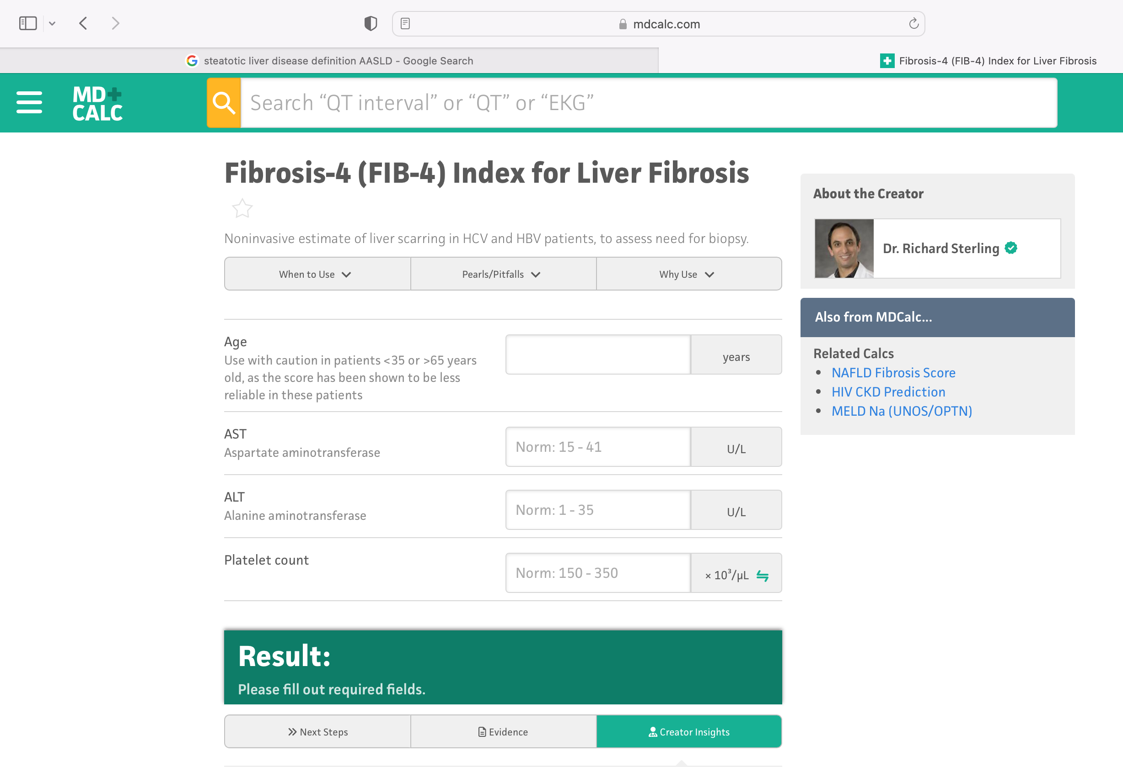
Staging disease non-invasively with FIB-4
Sterling R, Hepatology 2006 43 1317-25

Slide 13
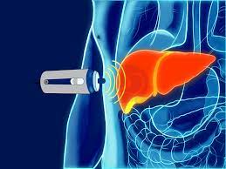
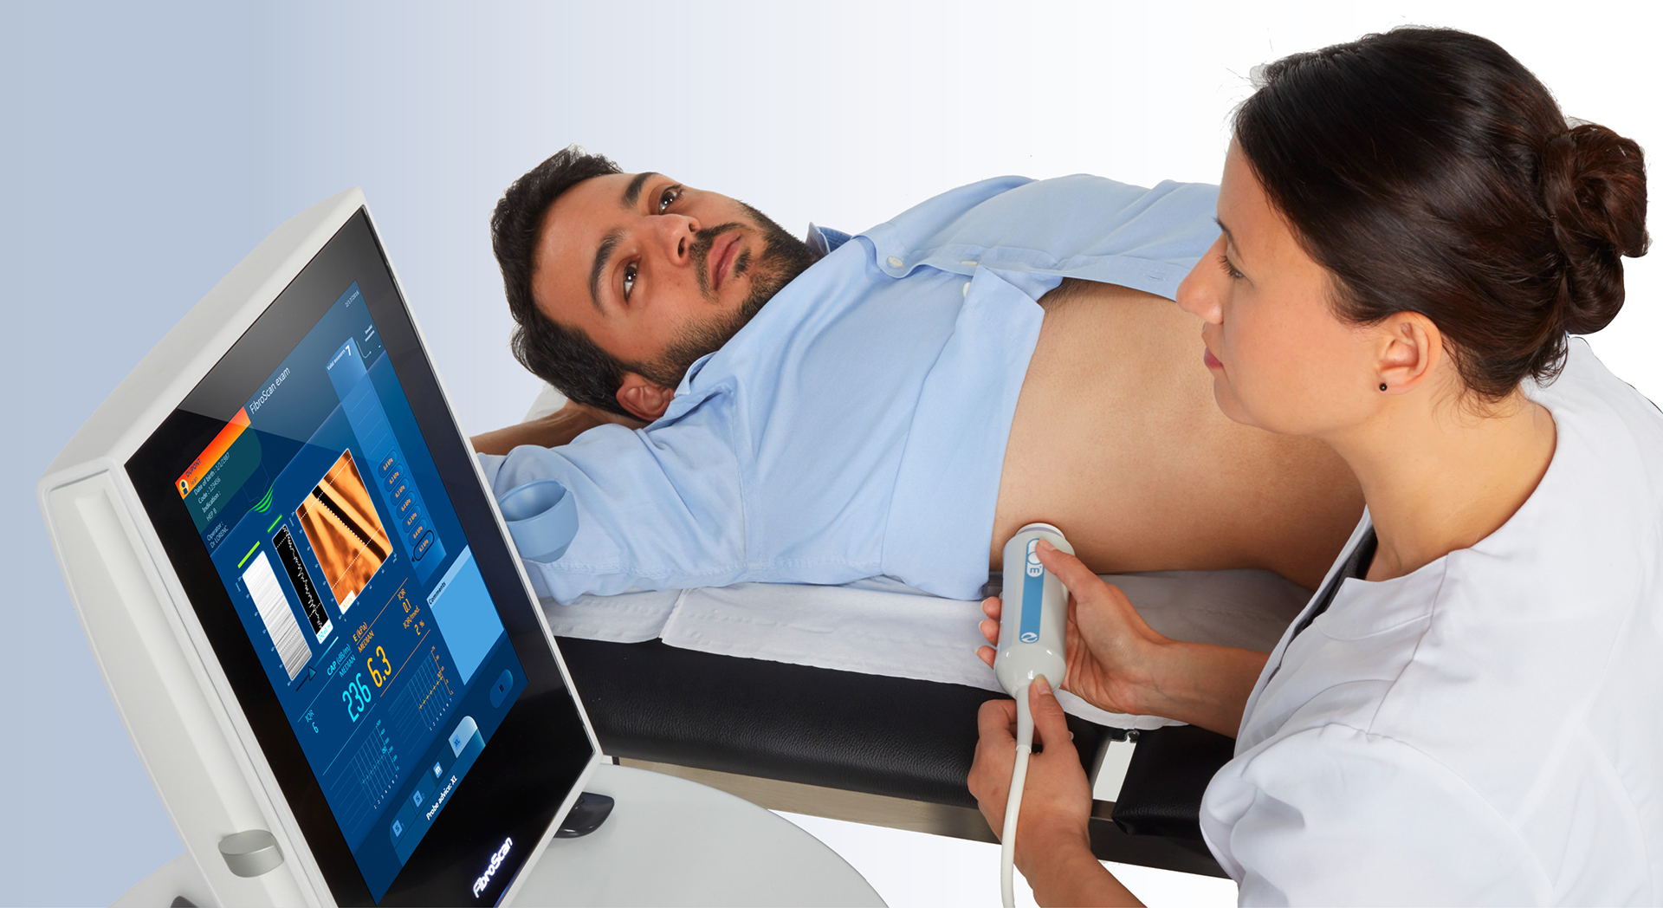
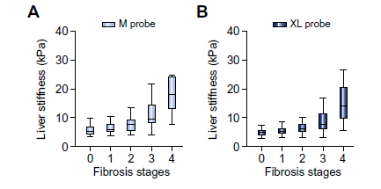
Transient Elastography (fibroscan)
De Ledinghen V, J Hepatol 2012; Myers RP, J Hepatol 2012; Wong V, Hepatology 2012

Slide 14
Suspected NAFLD
Overweight/obese
T2DM/Metabolic syndrome
Steatosis on imaging
Raised liver enzymes + metabolic features
Other liver disease excluded
Calculate FIB-4 score
less than or equal to
1.30 (<65yrs)
2.0 (≥65 yrs)
More than
1.3 (<65yrs)
2.0 (≥65 yrs)
Transient elastography (TE)
<8 KPa
≥8 KPa
Consider Referral to Hepatology
Low risk NAFLD
Consider further investigation
F0-1
F2-3
F4
Primary care
lifestyle advice,
treat metabolic risk,
Re-assess FIB-4/TE in 3 yrs
Treatment
Treatment
Surveillance/treat complications
Neilson L. Frontline Gastroenterology 2021

Slide 15
Lifestyle management
Explain that NAFLD is reversible with lifestyle change
Give brief advice to include:
Improving diet quality
Reducing calories, portion size etc
Improving activity levels
Get a feel for their ‘readiness for change’
Set a weight loss target for their next visit
Short-term goals and long-term goals
Review progress at next appointment
If not improving, then arrange dietetic review or alternative weight loss approaches
Do not forget to discuss minimising/abstaining from alcohol

Slide 16
Neilson L. Frontline Gastroenterology 2021

Slide 17
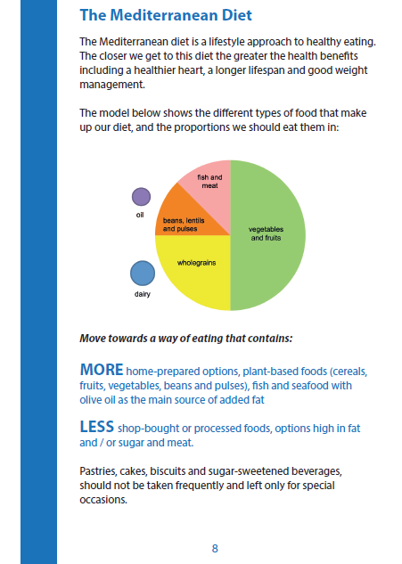
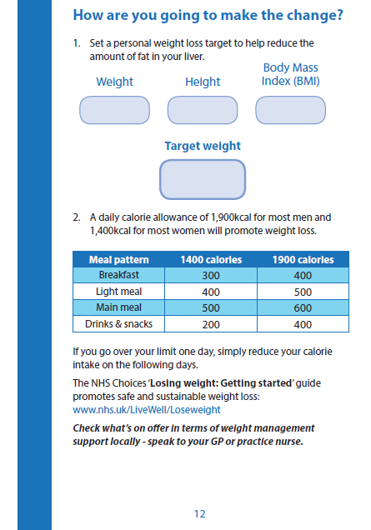
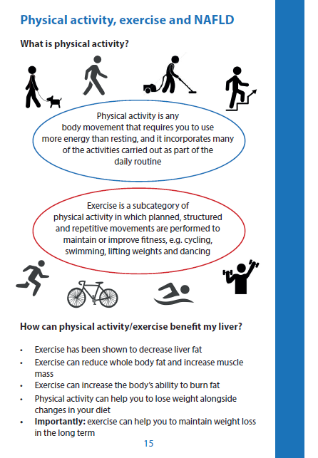
Provide good patient information
http://www.livernorth.org.uk/pdfs/LN11%20NAFLD.pdf

Slide 18
Surveillance for cirrhosis complications
Screening for varices
Surveillance for liver cancer every 6 months with Ultrasound
Screen for varices
Assess fracture risk with FRAX or DEXA
Mansour D et al. Frontline Gastroenterology 2023

Slide 19
Adenovirus delivered gene therapy
Raised transaminases common
AAV5-hFVIII
85% have transaminitis
AAV5-PdFIX
20% have transaminitis
Majority mild but some moderate/severe with AAV5-hFVIII
Potential mechanisms
Antiviral immune response
Stress in the ER
Hepatitis linked to reduced efficacy of gene therapy
Mucke, M et al. J Hepatol 2023

Slide 20
Work up pre-treatment
Patients with advanced liver fibrosis were excluded from studies
Patients should be screened for liver disease pre-treatment
ARLD, HBV, HCV, steatotic liver disease, autoimmune liver disease
Stage fibrosis with fibroscan
<11.5 kPa ok to proceed, >11.5 kPa then discuss with hepatologist
Optimise liver pre-treatment
Treat HBV or HCV
Abstain from alcohol
Lifestyle change and optimize metabolic risk factors for SLD

Slide 21
Monitoring and treatment
Can occur from week 1 onwards (median 8 weeks)
Weekly liver enzymes for 6 months, then monthly for 2 years
Prompts initiation of steroids
60mg Prednisolone tapered of 8-12 weeks
Can have secondary rise in liver enzymes so continue monitoring post treatment
Other immunosuppressants have been used
Budesonide, MMF, azathioprine, tacrolimus
Studies of prophylactic immunosuppression ongoing
Remember people with past or current HBV can reactivate/flare on steroids if not on antivirals so monitor or offer prophylaxis.
Consider other causes if severe liver enzymes rise.

Slide 22
Conclusions
Liver disease is common and opportunities for early diagnosis and treatment are frequently missed
Go looking for liver disease and use a test for fibrosis to identify cases of more severe fibrosis
Raised transaminases are seen frequently with adenovirus gene therapy and it associated with reduced efficacy
Prompt initiation of steroids leads to resolution in the majority with an 8-12 week tapering course
There are many unanswered questions regarding the mechanisms and treatment of this complication.

Slide 23
Questions? stuart.mcpherson2@nhs.net

