Slide 1
Current laboratory testing in von Willebrand disease
Sean Platton – Consultant Biomedical Scientist, Royal London Hospital Haemophilia Centre

Slide 2
Declaration of interests
Speaker fees | None
Consultancy fees | Pfizer; Sanofi
Travel and/or accommodation | Sysmex UK; Stago UK
Others | None

Slide 3
von Willebrand Disease [VWD]
Reduction of VWF or non-functioning VWF
  Binds to collagen on epithelial surface and GPIb on platelets
  Also protects FVIII from proteolysis
Most frequent heritable bleeding disorder
1% of population
  Clinically significant in only 1% of that 1% (100 per million)
  Affects males and females equally
Symptoms include:
  epistaxis
  menorrhagia
  bruising
  gastrointestinal bleeding

Slide 4
VWD classification
Type | Description | Clinical severity | Frequency
1 | Reduced levels of VWF | Mild-moderate | 60-80%
2 | Dysfunctional VWF | Moderate-severe | 15-20%
2A | Absent high molecular weight multimers Impaired binding to collagen
2M | All multimers present Impaired binding to platelet GPIb
2B | Increased binding affinity to platelets
2N | Impaired binding to factor VIII Reduced FVIII:c
3 | Absent VWF Near absent FVIII:c | Severe | 1-5%

Slide 5
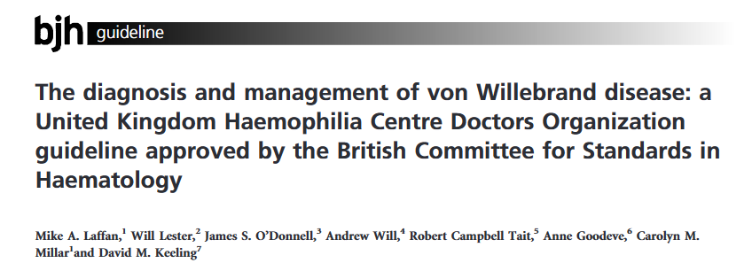
Diagnostic guidelines
B J Haem 2014;167(4);453-465

Slide 6
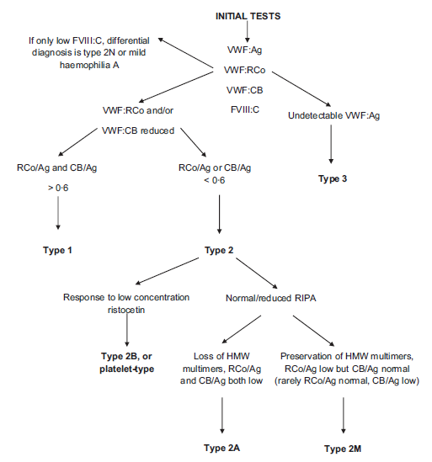
B J Haem 2014;167(4);453-465

Slide 7
B J Haem 2014;167(4);453-465

Slide 8
Diagnostic guidelines
Since 2014:
New assays for VWF function:
  VWF:GPIbM
  VWF:GPIbR
Easier assays for VWF:RCo
Easier access to VWF:CB
Easier access to genomics

Slide 9
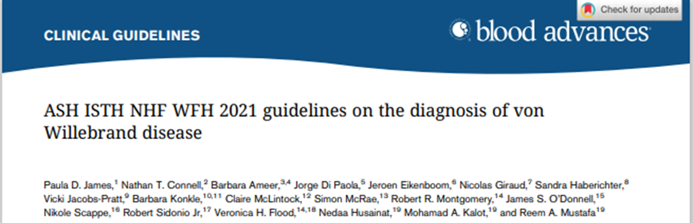
Diagnostic guidelines
James et al, ASH ISTH NHF WFH 2021 guidelines on the diagnosis of von Willebrand disease. Blood Adv, 2021;5:280-300

Slide 10
Diagnostic guidelines
James et al, ASH ISTH NHF WFH 2021 guidelines on the diagnosis of von Willebrand disease. Blood Adv, 2021;5:280-300

Slide 11
Diagnostic guidelines
Recommendation that VWF:RCo assays are not used
James et al, ASH ISTH NHF WFH 2021 guidelines on the diagnosis of von Willebrand disease. Blood Adv, 2021;5:280-300

Slide 12
Diagnostic guidelines
James et al, ASH ISTH NHF WFH 2021 guidelines on the diagnosis of von Willebrand disease. Blood Adv, 2021;5:280-300

Slide 13
Diagnostic guidelines
Guidelines for Laboratory Diagnosis and Monitoring of von Willebrand Disease: a Joint Guideline from the United Kingdom Haemophilia Centres Doctors’ Organisation and the British Society of Haematology.
Sean Platton, Peter Baker, Annette Bowyer, Catriona Keegan, Caroline Lawrence, Will Lester, Anne Riddell, Megan Sutherland
Platton et al, submitted for peer review

Slide 14
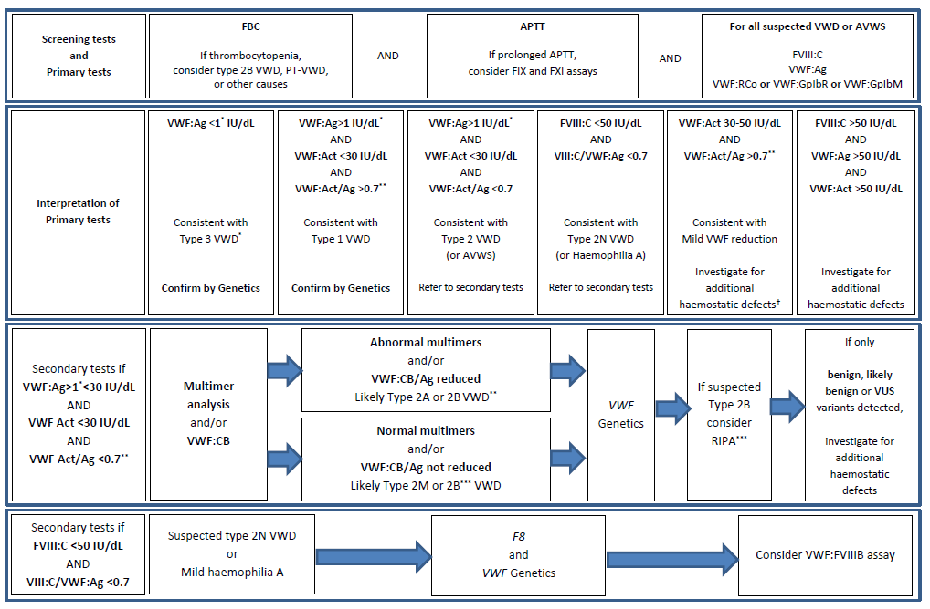
Diagnostic guidelines
Platton et al, BSH/UKHCDO VWD diagnostic guideline, submitted for peer review

Slide 15
Diagnostic guidelines
Platton et al, BSH/UKHCDO VWD diagnostic guideline, submitted for peer review

Slide 16
Diagnostic guidelines
Platton et al, BSH/UKHCDO VWD diagnostic guideline, submitted for peer review

Slide 17
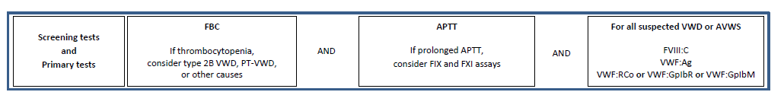
Screening tests and primary tests
Units
IU/dL to nearest whole number
Reference ranges

Slide 18
Primary tests
Factor VIII
One-stage clotting assay or chromogenic
VWF:Ag
Can be measured by latex immunoassay or ELISA
Lower limit of quantitation is above 1 IU/dL for LIA
VWF activity
Measure by VWF:RCo, VWF:GPIbR or VWF:GPIbM
No requirement for VWF:CB to be included as a primary test

Slide 19
Primary tests – VWF:RCo
Platelet agglutination technique
Imprecise
LLoQ ~10 IU/dL with many techniques
Precision and LLoQ improved with automation
Reduced in presence of p.(Arg1472His) variant
Not associated with a bleeding diathesis
High MAF (0.10 Europeans, 0.11 East Asians, 0.15 South Asians, 0.55 Africans)*
Some patients with a historical diagnosis of type 1 or 2 VWD may have mild VWF reduction or no disease
ASH guideline recommends against use
* rs1800383 RefSNP Report - dbSNP - NCBI (nih.gov), accessed 22nd September 2022

Slide 20
Primary tests – VWF:GPIbR
Automated LIA or CLIA, measures binding to GPIb-fragment in presence of ristocetin
HemosIL VWF:RCo LIA measures VWF:GPIbR
AcuStar VWF:RCo CLIA measures VWF:GPIbR
Sometimes reduced in presence of p.(Arg1472His) variant

Slide 21
Primary tests – VWF:GPIbM
Automated LIA, measures binding to GPIb-fragment modified with two gain-of-function mutations
Siemens INNOVANCE VWF:Ac LIA measures VWF:GPIbM
Does not use ristocetin: not affected by p.(Arg1472His) variant
Overestimation in type 3 VWD and AVWS

Slide 22
Laboratory assays not recommended
PFA-100/200
False positives and false negatives
Bleeding time
VWF:Ab assays do not measure VWF function
Overestimate VWF in 2M VWD and in 2A with p.(Val1665Glu)
HemosIL VWF activity LIA measures VWF:Ab
ELISA for VWF:GPIbR or VWF:GPIbM
overestimates in type 2B and 2M
Flow cytometric techniques

Slide 23
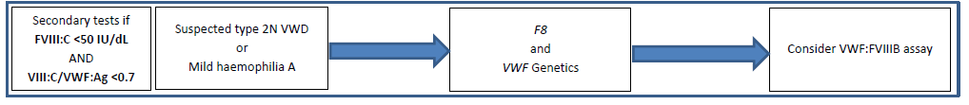
Secondary tests – FVIII-binding assay
Not standardised
No EQA scheme
Type 2N (Normandy) should be differentiated from haemophilia A by F8 and VWF genetics in preference to (or as well as) a FVIII-binding assay

Slide 24
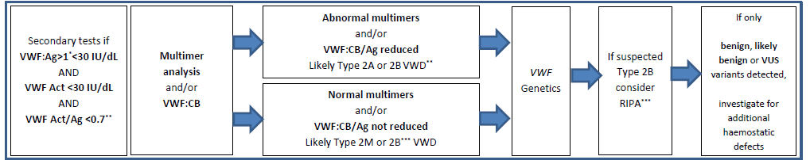
Secondary tests

Slide 25
Secondary tests – VWF:CB
Measured by ELISA or CLIA using type 1 and/or type 3 collagen
Some patients have defect in binding to type 6 collagen
If the only activity assay performed is VWF:CB then type 2A VWD can be misdiagnosed as type 1
In rare patients all other assays may be normal

Slide 26
Secondary tests - multimers
Usually performed by Western blotting – three day assay
New commercial assay takes six hours
Triplets cannot be visualised using this technique
Densitometry can be performed

Slide 27
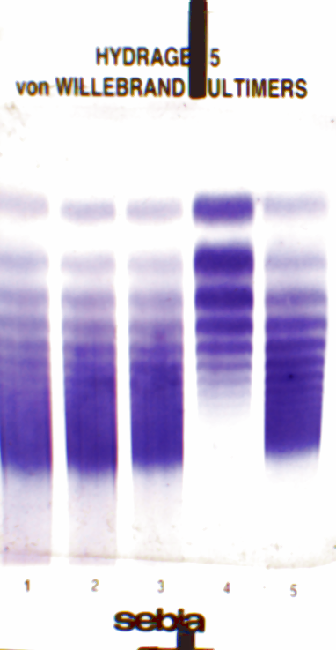
4. VWF:Ag 80 IU/dl VWF:Act 20 IU/dl
With thanks to Dr Annette Bowyer, Sheffield Teaching Hospitals NHS Foundation Trust

Slide 28
Secondary tests - multimers
Some evidence that VWF:CB-to-antigen ratio can be used instead of multimers, but not as sensitive

Slide 29
Secondary tests - genetics
Can be used once phenotypic tests are completed
Can be used instead of some tests to confirm a diagnosis
What should be done if the variant detected is:
Variant of unknown significance; or
A benign or likely-benign variant; or
Not previously described

Slide 30
Secondary tests – ristocetin induced platelet agglutination [RIPA]
Light transmission aggregometry using two different doses of ristocetin to confirm type 2B and PT-VWD
If there is response to low dose ristocetin, mixing studies can be performed to differentiate between the two
Not standardised, no EQA, technically difficult
Type 2B and PT-VWD should be diagnosed by genetics in preference to (or as well as) a RIPA

Slide 31
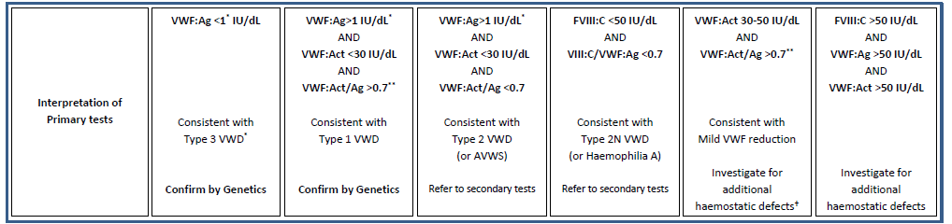
Secondary tests – VWF propeptide assay
Not standardised
No EQA scheme
Type 1C (Vicenza) should be diagnosed by genetics in preference to (or as well as) a DDAVP trial and/or VWFpp assay

Slide 32
Inhibitor assays
May be required to differentiate between VWD and AVWS
AVWS mechanistic and multiple causes
Bethesda style assay, sample dilutions in buffer
Incubation time not studied, but 15 minutes thought to be sufficient
Any activity assay can be used to measure residual VWF
Some evidence that VWF:CB is the most sensitive

Slide 33
Pregnancy
Diagnosis should be avoided during pregnancy
pregnancy-specific reference ranges not required
Monitoring of VWF levels during pregnancy in previously diagnosed patients may be required
Monitoring of VWF levels in pregnancy require FVIII:C, VWF:Ag and VWF activity
Activity assay can be VWF:RCo, VWF:GPIbR or VWF:GPIbM

Slide 34
Neonates and infants
Potential sample quality issues around birth and in young neonates, as well as high levels of VWF around birth
Diagnosis should generally be avoided unless it is going to affect patient management
Type 3 and severe type 2 VWD can be diagnosed
Consider genetics
Retest after six months
VWF:GPIbR can remain high until 1 year of age

Slide 35
DDAVP and VWF concentrates
When assessing response to DDAVP, FVIII:C, VWF activity and VWF:Ag should be measured
FVIII:C by one-stage clotting or chromogenic assay
VWF activity by VWF:RCo, VWF:GPIbR or VWF:GPIbM
When assessing response to a VWF-concentrate, FVIII:C and VWF activity should be measured
VWF:Ag not likely to be useful
FVIII:C by one-stage clotting or chromogenic assay to identify potential accumulation of FVIII
VWF activity by VWF:RCo, VWF:GPIbR or VWF:GPIbM

Slide 36
VWF concentrates
Assay Type | Manufacturer’s kit
VWF antigen (VWF:Ag) | Hyphen Biomed LIAPHEN VWF:Ag [LIA] Hyphen Biomed Zymutest vWF [ELISA] Siemens vWF Ag [LIA] Stago Asserachrom VWF:Ag [ELISA] Stago STA Liatest VWF:Ag [LIA] Technoclone Technozym vWF:Ag [ELISA] Werfen AcuStar von Willebrand Factor: Ag [CLIA]
VWF activity (VWF:RCo) | Siemens BC von Willebrand [platelet agglutination] Stago STA-VWF:RCo [platelet agglutination]
VWF activity (VWF:GpIbR) | Werfen AcuStar von Willebrand Factor: RCo [ELISA] Werfen HemosIL VWF:RCo activity assay [LIA]
VWF activity (VWF:GpIbM) | Siemens INNOVANCE VWF:Ac [LIA]
VWF activity (VWF:CB) | Hyphen Biomed Zymutest vWF:CBA [ELISA] Stago Asserachrom VWF:CB [ELISA] Technoclone Technozym vWF:CBA [ELISA] Technoclone Technozym vWF:CBA Collagen Type I [ELISA] Technoclone Technozym vWF:CBA Collagen Type VI [ELISA] Werfen AcuStar von Willebrand Factor: CB [CLIA]
VWF FVIII binding (VWF:FVIIIB) | Stago Asserachrom VWF:FVIIIB [ELISA]
VWF activity (VWF:Ab) | Werfen HemosIL VWF activity [LIA]

