Slide 1
Against the routine use of BATs in clinical practice
Dr Dearbhla Doherty
Haematology Specialist Registrar & Clinical Fellow
Royal College of Surgeons in Ireland

Slide 2
Potential Clinical Uses of BATs
2) Prognostic
Categorize patients by severity
of bleeding phenotype
Diagnostic
Screening test to identify patients
with inherited bleeding disorders (IBD)

Slide 3
Potential Clinical Uses of BATs
Diagnostic
Screening test to identify patients
with inherited bleeding disorders (IBD)
What is the normal range?

Slide 4
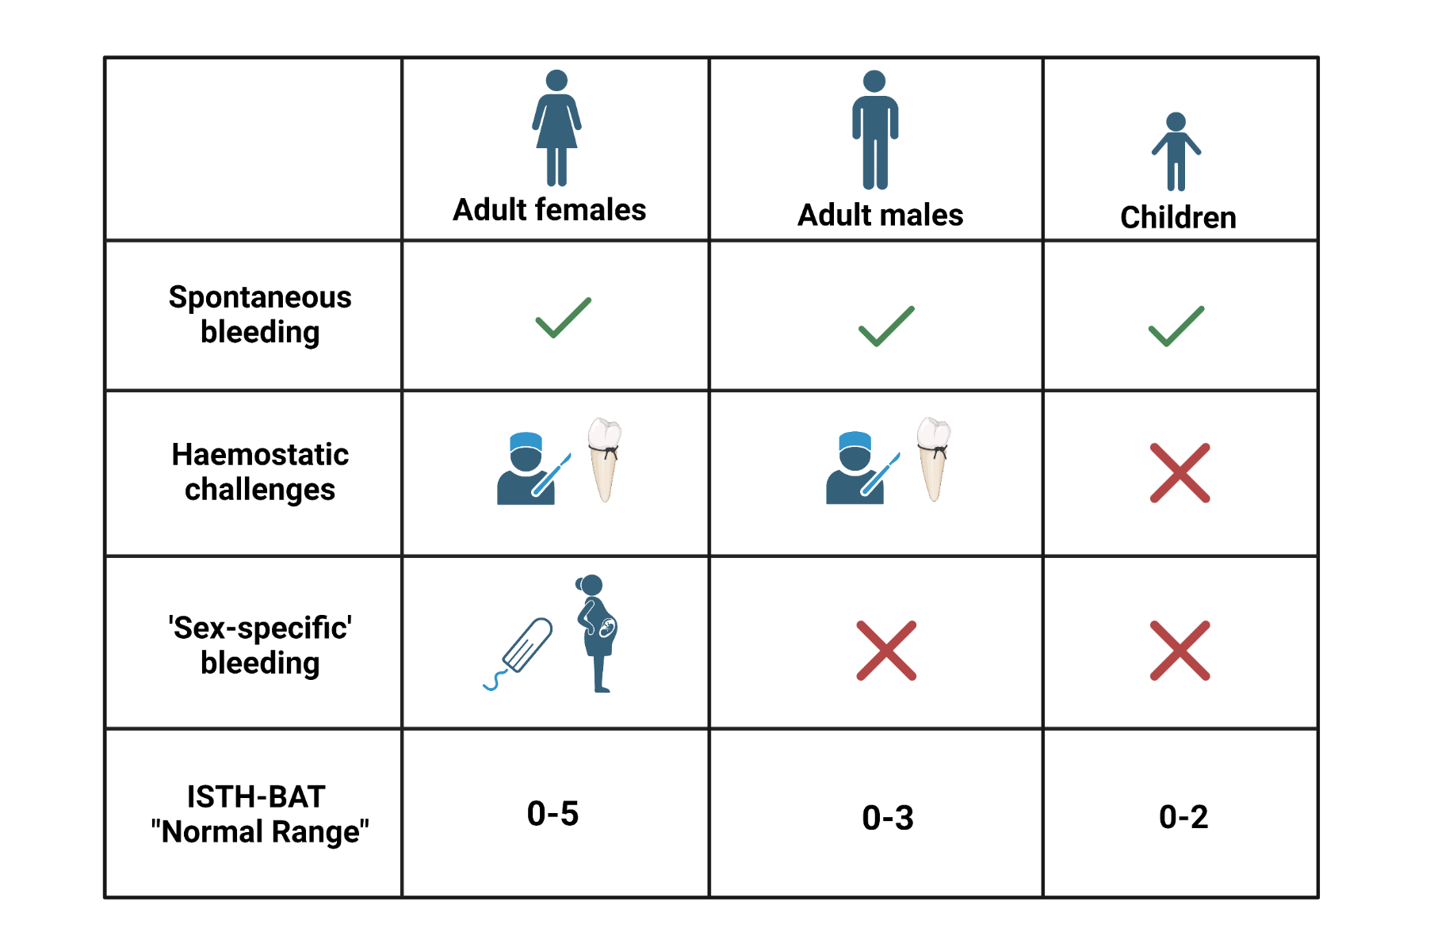
Uses of BATs What is the normal range?
.
1040 Adult, 328 Paediatric Healthy Controls
Elbatarny et al, Haemophilia, 2014

Slide 5
Uses of BATs What is the normal range?
.
1040 Adult, 328 Paediatric Healthy Controls
Elbatarny et al, Haemophilia, 2014

Slide 6
Issues with current normal ranges ISTH-BAT varies with ageing in healthy females
Increasing variability in BAT with normal ageing
Quartile 1
Middle 95th centile
0-4
Quartiles 2 & 3
Middle 95th centile
0-5
Quartile 4
Middle 95th centile
0-6
Doherty et al, J Thromb Haemost. 2023

Slide 7
Issues with current normal ranges ISTH-BAT varies with ageing in healthy females
Doherty et al, J Thromb Haemost. 2023

Slide 8
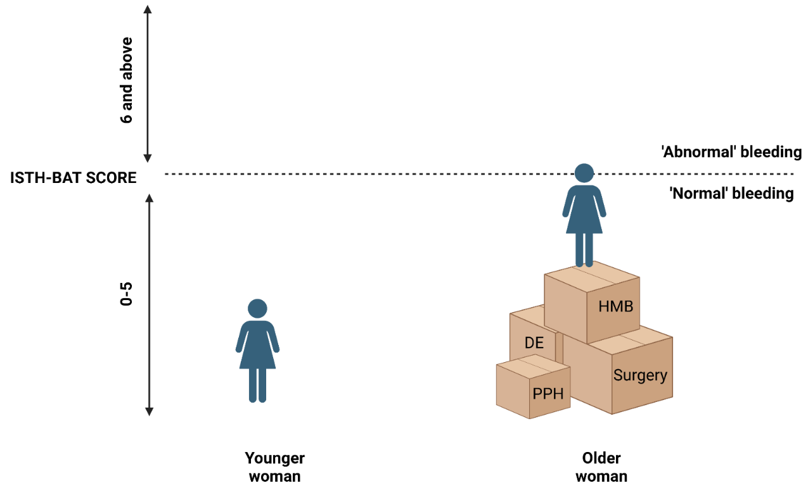
Issues with current normal ranges ISTH-BAT: Time for age-adjusted normal ranges?
When used as screening test, upper limit of the normal range serves as a medical decision limit
With current (unadjusted) ranges
Younger patients may be at risk of under-referral/ investigation
Older patients may be at risk of over-referral/ investigation
Doherty et al, J Thromb Haemost. 2023

Slide 9
Issues with current normal ranges ISTH-BAT: Time for age-adjusted normal ranges?
When used as screening test, upper limit of the normal range serves as a medical decision limit
With current (unadjusted) ranges
Younger patients may be at risk of under-referral/ investigation
Older patients may be at risk of over-referral/ investigation
Age adjusted normal ranges may overcome this issue
Need validation before adopt in clinical practice

Slide 10
Issues with current normal ranges Self-BAT
Self-BAT
Same normal ranges as ISTH-BAT
0-3 Adult Males, 0-5 Adult Females, 0-2 Children
57 Adult Healthy Controls
Deforest et al, Haemophilia, 2015
Hansen et al, Haemophilia, 2022

Slide 11
Issues with current normal ranges Self-BAT
Self-BAT
Same normal ranges as ISTH-BAT
0-3 Adult Males, 0-5 Adult Females, 0-2 Children
57 Adult Healthy Controls
Danish study
553 women, 454 men
Normal range suggested as:
0-4 Adult Males, 0-8 Adult Females
Deforest et al, Haemophilia, 2015
Hansen et al, Haemophilia, 2022

Slide 12
Potential Clinical Uses of BATs
Diagnostic
Screening test to identify patients
with inherited bleeding disorders (IBD)
What is the normal range?

Slide 13
Potential Clinical Uses of BATs
Diagnostic
Screening test to identify patients
with inherited bleeding disorders (IBD)
What is the normal range?
Prospectively validate ability to discriminate patients with IBDs

Slide 14
BATs in screening individuals for IBD ASH/ISTH/NHF/WFH Guidelines VWD Diagnosis
Meta-analysis of BAT performance in identifying patients with VWD
Pooled sensitivity and specificity 75% and 54%
Sensitivity of up to 100% for adult women in some studies
Kalot et al, Blood Adv, 2022

Slide 15
BATs in screening individuals for IBD ASH/ISTH/NHF/WFH Guidelines VWD Diagnosis
Meta-analysis of BAT performance in identifying patients with VWD
Pooled sensitivity and specificity 75% and 54%
Sensitivity of up to 100% for adult women in some studies
Low prevalence setting (eg. primary care) due to high NPV
recommends using a validated bleeding-assessment tool (BAT)
as an initial screening test to determine who needs specific blood testing
Kalot et al, Blood Adv, 2022

Slide 16
BATs in screening individuals for IBD Evidence is based on ++ heterogeneous studies
7 studies included in
meta-analysis to analyse sensitivity and specificity
Notes:
Diagnostic test accuracy of BATs in VWD

Slide 17
BATs in screening individuals for IBD Evidence is based on ++ heterogeneous studies
Kalot et al, Blood Advances, 2022
Notes:
Diagnostic test accuracy of BATs in VWD

Slide 18
BATs in screening individuals for IBD Evidence is based on ++ heterogeneous studies
Multiple different bleeding scores
2 studies include “composite scores”
(ie. more that a BAT!)
eg. Philipp Questionnaire –
Bleeding symptoms
Hx of anaemia
FHx bleeding d/o
Philipp et al, Am J Obstet Gynecol, 2008
Notes:
Diagnostic test accuracy of BATs in VWD

Slide 19
BATs in screening individuals for IBD Evidence is based on ++ heterogeneous studies
Multiple different bleeding scores
2 studies include “composite scores”
(ie. more that a BAT!)
eg. Philipp Questionnaire –
Bleeding symptoms
Hx of anaemia
FHx bleeding d/o
Cannot infer the performance of a bleeding score only (eg. ISTH-BAT) from analysis that includes composite scores
Philipp et al, Am J Obstet Gynecol, 2008
Notes:
Diagnostic test accuracy of BATs in VWD

Slide 20
BATs in screening individuals for IBD Evidence is based on ++ heterogeneous studies
Multiple different bleeding scores
No prospective study on ISTH-BAT (in adults)
met inclusion criteria
Kalot et al, Blood Advances, 2022
Notes:
Diagnostic test accuracy of BATs in VWD

Slide 21
BATs in screening individuals for IBD Evidence is based on ++ heterogeneous studies
Multiple different bleeding scores
Different bleeding scores perform differently!
→ Condensed MCMDM1 is less sensitive for the assessment of HMB in female patients.
Kalot et al, Blood Advances, 2022
Lavin et al, Blood Advances, 2018
Notes:
Diagnostic test accuracy of BATs in VWD

Slide 22
BATs in screening individuals for IBD ASH/ISTH/NHF/WFH Guidelines VWD Diagnosis
Meta-analysis of BAT performance in identifying patients with VWD
Pooled sensitivity and specificity 75% and 54%
Sensitivity of up to 100% for adult women in some studies
Kalot et al, Blood Adv, 2022

Slide 23
BATs in screening individuals for IBD ASH/ISTH/NHF/WFH Guidelines VWD Diagnosis
Meta-analysis of BAT performance in identifying patients with VWD
Pooled sensitivity and specificity 75% and 54%
Sensitivity of up to 100% for adult women in some studies
“This recommendation applies predominantly to adult women, as the data supporting the use of a BAT as a screening tool is strongest in this patient group.”
Kalot et al, Blood Adv, 2022

Slide 24
BATs in screening individuals for IBD Evidence is based on small studies
“Sensitivity of up to 100% for adult women in some studies”
Only 3 studies recruited adults
Kalot et al, Blood Adv, 2022
Notes:
Diagnostic test accuracy of BATs in VWD

Slide 25
BATs in screening individuals for IBD Evidence is based on small studies
“Sensitivity of up to 100% for adult women in some studies”
Only 3 studies recruited adults
6/6 women with VWD had a positive BS (Bowman)
7/7 women with VWD had a positive BS (Deforest)
Kalot et al, Blood Adv, 2022
Notes:
Diagnostic test accuracy of BATs in VWD

Slide 26
Potential Clinical Uses of BATs
Diagnostic
Screening test to identify patients
with inherited bleeding disorders (IBD)
What is the normal range?
Prospectively validate ability to discriminate patients with IBDs

Slide 27
BATs in screening individuals for IBD Practical issues in a primary care setting
Duration of administration
ISTH-BAT 20 minutes
Up to 97 questions (!!)
Rydz et al, J Thromb Haemost, 2012

Slide 28
BATs in screening individuals for IBD Practical issues in a primary care setting
Duration of administration
ISTH-BAT 20 minutes
Up to 97 questions (!!)
Differences in guidelines
Von Willebrand Disease
ASH/ISTH/NHF/WHO 2021
“recommends using a validated bleeding-assessment tool (BAT) as an initial screening test”
Inherited platelet disorders
BSH 2021, ISTH SSC 2015
“The use of a BAT…is not sensitive enough to determine the need for laboratory testing”
James et al, Blood Advances, 2021
Gomez et al, Br J Haematol, 2021
Gresele et al, J Thromb Haemost, 2015
.
Notes:
Rodeghiero et al – minimal benefit to detailed questionnaire. 2005

Slide 29
BATs in screening individuals for IBD Practical issues in a primary care setting
.
Duration of administration
ISTH-BAT 20 minutes
Up to 97 questions (!!)
Differences in guidelines
James et al, Blood Advances, 2021
Gomez et al, Br J Haematol, 2021
Gresele et al, J Thromb Haemost, 2015
.

Slide 30
Sufficient evidence for use of BATs in clinical practice? Not yet!
BATs may be useful in clinical practice in the future
Large healthy control studies to define ideal cut-offs appropriate to a person’s age and haemostatic challenges
Prospective validation (ideally of a single BAT) in large numbers of individuals with suspected IBDs
Agreement in guidelines for mild-moderate inherited bleeding disorders
Moenen et al, Haemophilia, 2018

Slide 31
Sufficient evidence for use of BATs in clinical practice? Not yet!
BATs may be useful in clinical practice in the future
Large healthy control studies to define ideal cut-offs appropriate to a person’s age and haemostatic challenges
Prospective validation (ideally of a single BAT) in large numbers of individuals with suspected IBDs
Agreement in guidelines for mild-moderate inherited bleeding disorders
For now:
“The BAT offers a structured approach” to the bleeding history for unexperienced physicians
Moenen et al, Haemophilia, 2018

Slide 32
Thank you

